Slide 1
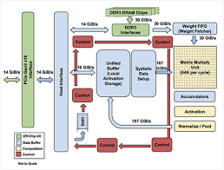
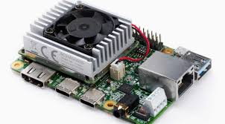
Computer Architecture
By Yu Lasheng
School of Computer Science and Engineering
Email: apple6097@163.com
Sharing Email:
assignment_arch@163.com/architect Office:
计算机楼 /southern campus blding 2
QQ群
TPU board
TPU datapath

Slide 2

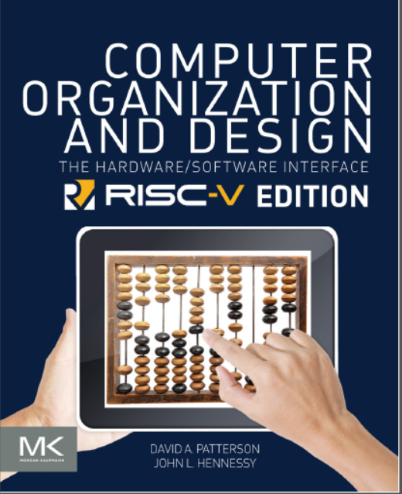
教材与主要参考书
John L. Hennessy, David A. Patternson; Computer Architecture: A Quantitative Approach; sixth Edition.
David A. Patternson, John L. Hennessy ; Computer Organization and Design- The Hardware/Software Interface; RISC-V Edition.

Slide 3
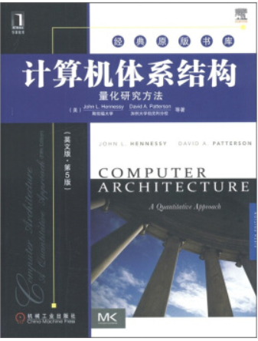
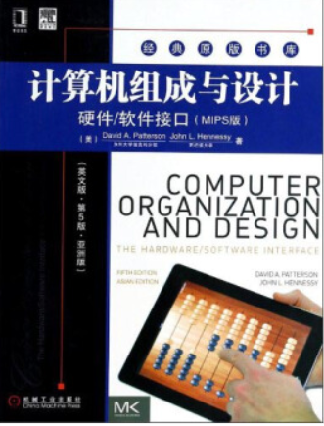
教材与主要参考书
John L. Hennessy, David A. Patternson；Computer Architecture: A Quantitative Approach. Fifth Edition. 机械工业出版社，2012
作者：John L.Hennessy（斯坦福大学校长）和David A.Patterson （加州大学伯克利分校）
David A. Patternson, John L. Hennessy, Computer Organization & Design : The Hardware/Software Interface, Third Edition. San Francisco: Morgan Kaufmann Publishers, Inc. 2005

Slide 4
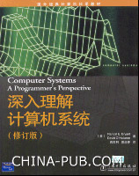
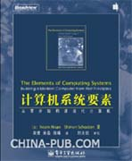
教材与主要参考书
深入理解计算机系统（修订版）
http://www.china-pub.com/18133
作者：Randal E.Bryant（CMU计算机系系主任）; David O‘Hallaron（CMU）
所有想写出更快、更可靠程序的开发人员必读之书，最伟大计算机科学教材之一。
计算机系统要素:从零 开始构建现代计算机
MIT Press

Slide 5
Questions for the course
Why do you choose this course?
What do you want to get from this course?

Slide 6

Computer Architectures
Structure & Organization, parallelism is even more fun
It impacts every other aspect of electrical engineering and computer science
Making it efficient, that's really fun!
It has never been more exciting!
Wish you a very nice course !!

Slide 7
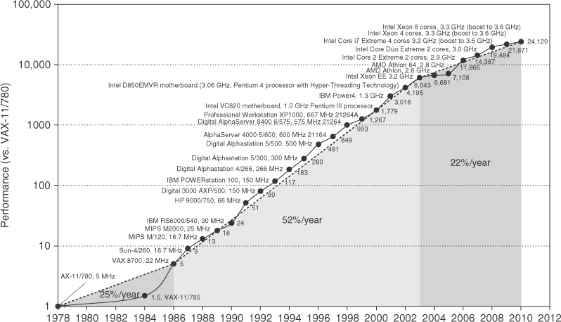
Performance of (single) processors

Slide 8
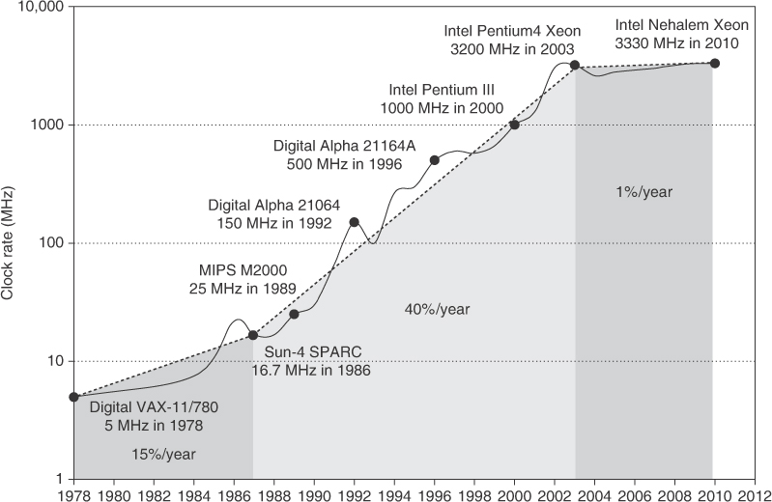
Frequency development of processors

Slide 9
Where Has This Performance Improvement Come From?
Technology
More transistors per chip
Faster logic
Machine Organization/Implementation
Deeper pipelines
More instructions executed in parallel
Instruction Set Architecture
Reduced Instruction Set Computers (RISC)
Multimedia extensions
Explicit parallelism
Compiler technology
Finding more parallelism in code
Greater levels of optimization
OISC?

Slide 10
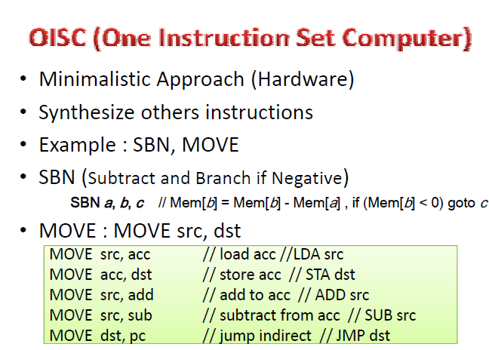
OISC

Slide 11
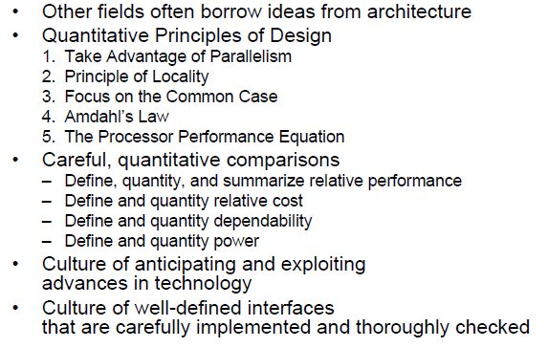
What Computer Architecture brings to Table

Slide 12
Your First Assignment
Recall your favorite and Memorable building
Appreciate the importance of out-of-the-box and creative thinking
Think about tradeoffs in the design of the building
Strengths, weaknesses
Derive principles on your own for good design and innovation
Due date: After 2 weeks
Notes:
网络开箱即用; 即开即用; 开包即用; 开箱即用的; 即装即用

Slide 13
A Key Hint Question
How Was the Designer Able To Design a blding?
Can have many guesses
(Ultra) hard work, perseverance, dedication (over decades)
Experience of decades
Creativity
Out-of-the-box thinking
Principled design
A good understanding of past designs
Good judgment and intuition
Strong combination of skills (math, architecture, art, …)
…
(You will be exposed to and hopefully develop/enhance many of these skills in this course)
architecture based upon principle, and not upon precedent
Notes:
基于原则而非先例的架构
良好的判断力和直觉

Slide 14
Takeaways
Being an architect is not easy
You need to consider many things in designing a new system + have good intuition/insight into ideas/tradeoffs
But, it is fun and can be very technically rewarding
And, enables a great future
E.g., many scientific and everyday-life innovations would not have been possible without architectural innovation that enabled very high performance systems
E.g., your mobile phones
Let’s try it together
Notes:
在设计新系统时需要考虑很多事情+对想法/权衡有很好的直觉/洞察力

Slide 15
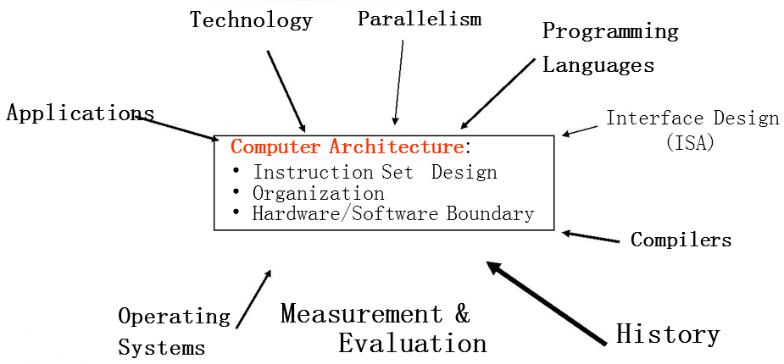
Forces on Computer Architecture
Computer architecture has been at the core of such technological development and is still on a forward move
Notes:
History/Applications matters because
1) People buy computers to run programs
2) Most people don’t write own programs
3) Documented IDA interface means people ship binary machine code

Slide 16
Technology
Applications and Languages
Processor
logic capacity: about 30% per year
clock rate: about 20% per year
So… advanced functions (e.g., multimedia functions in some Pentiums) and high-speed features (multiple pipelines, larger caches)
Memory
DRAM capacity: about 60% per year (4x every 3 years)
Memory speed: about 10% per year
Cost per bit: improves about 25% per year
So… larger memory => more challenging applications (e.g., atmospheric modeling, astrophysics modeling)
Disk
capacity: about 60% per year
So … huge disk capacities => large data storage (video, music files, large data for various applications)
CAD, CAM, CAE, . . .
Lotus, DOS, . . .
Multimedia, . . .
The Web, . . .
JAVA, . . .
Large Scientific Computations
???

Slide 17
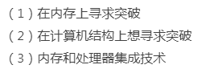
Computer Architecture Today (I)
Today is a very exciting time to study computer architecture
Industry is in a large paradigm shift (to multi-core and beyond) – many different potential system designs possible
Many difficult problems motivating and caused by the shift
Power/energy constraints → multi-core?
Complexity of design → multi-core?
Difficulties in technology scaling → new technologies?
Memory wall/gap
Reliability wall/issues
Programmability wall/problem
Huge hunger for data and new data-intensive applications
No clear, definitive answers to these problems
fault tolerance, on the scalability of peta/ exascale supercomputing,……

Slide 18
Computer Architecture Today (II)
These problems affect all parts of the computing stack – if we do not change the way we design systems
No clear, definitive answers to these problems
Many new demands
from the top
(Look Up)
Problem
Algorithm
Program/Language
User
Fast changing
demands and
personalities
of users
(Look Up)
Runtime System
(VM, OS, MM)
ISA
Microarchitecture
Many new issues
at the bottom
(Look Down)
Logic
Circuits
Electrons

Slide 19
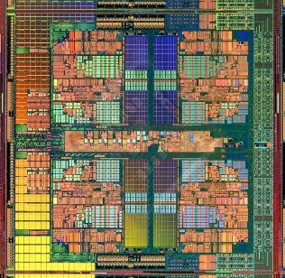
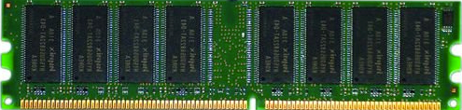
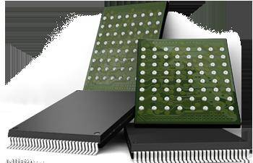
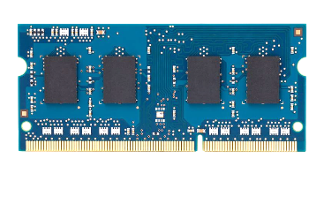
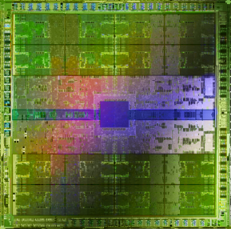
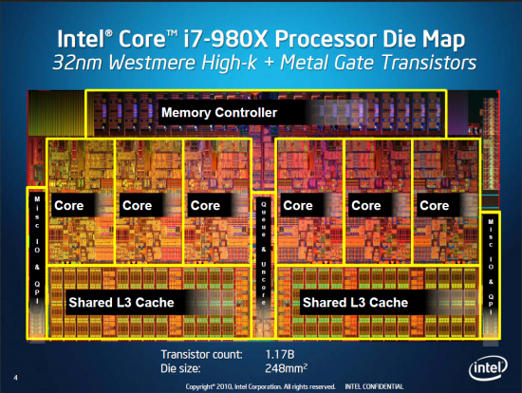
Computer Architecture Today (III)
Computing landscape is very different from 10-20 years ago
Both UP (software and humanity trends) and DOWN (technologies and their issues), FORWARD and BACKWARD, and the resulting requirements and constraints
Hybrid Main Memory
Heterogeneous
Processors and
Accelerators
Persistent Memory/Storage
Every component and its
interfaces, as well as
entire system designs
are being re-examined
General Purpose GPUs

Slide 20
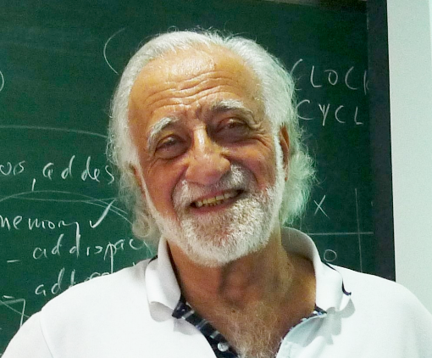
Computer Architecture Today (IV)
Look backward (to the past)
Understand tradeoffs and designs, upsides/downsides, past workloads. Analyze and evaluate the past.
Look forward (to the future)
Be the dreamer and create new designs. Listen to dreamers.
Push the state of the art. Evaluate new design choices.
Look up (towards problems in the computing stack)
Understand important problems and their nature.
Develop architectures and ideas to solve important problems.
Look down (towards device/circuit technology)
Understand the capabilities of the underlying technology.
Predict and adapt to the future of technology (you are designing for N years ahead). Enable the future technology.
from Yale Patt’s lecture notes

Slide 21
Computer Architecture Today (V)
You can revolutionize the way computers are built, if you understand both the hardware and the software (and change each accordingly)
You can invent new paradigms for computation, communication, and storage
Recommended book: Thomas Kuhn, “The Structure of Scientific Revolutions” (1962)
Pre-paradigm science: no clear consensus in the field
Normal science: dominant theory used to explain/improve things (business as usual); exceptions considered anomalies
Revolutionary science: underlying assumptions re-examined

Slide 22



Computer Architecture Today (VI)
You can revolutionize the way computers are built, if you understand both the hardware and the software (and change each accordingly)
You can invent new paradigms for computation, communication, and storage
Recommended book: Thomas Kuhn, “The Structure of Scientific Revolutions” (1962)
Pre-paradigm science: no clear consensus in the field
Normal science: dominant theory used to explain/improve things (business as usual); exceptions considered anomalies
Revolutionary science: underlying assumptions re-examined

Slide 23
… But, first …
Let’s understand the fundamentals…
You can change the world only if you understand it well enough…
Especially the past and present dominant paradigms
And, their advantages and shortcomings – tradeoffs
And, what remains fundamental across generations
And, what techniques you can use and develop to solve problems

Slide 24
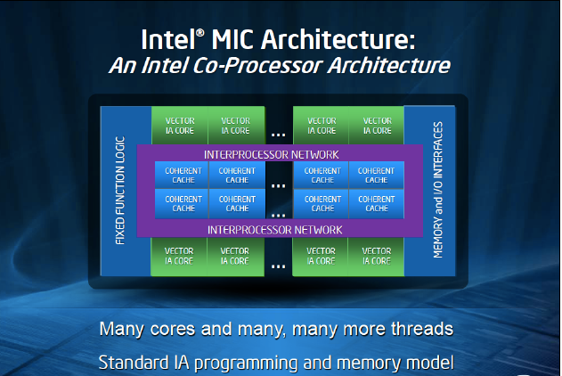
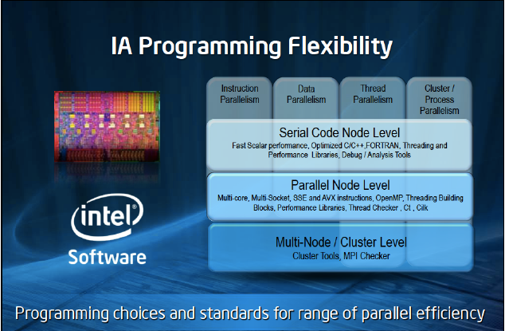
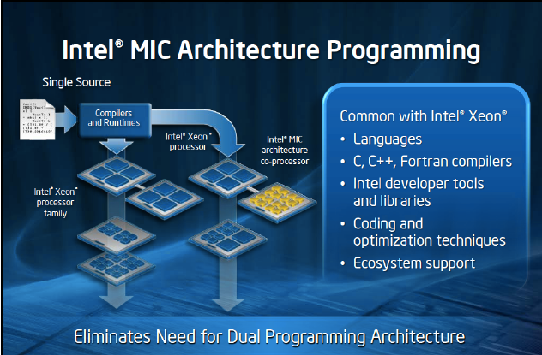
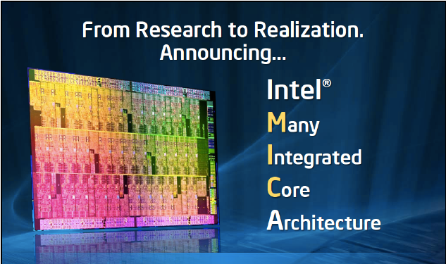
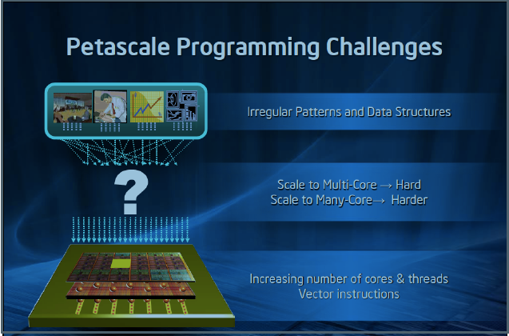
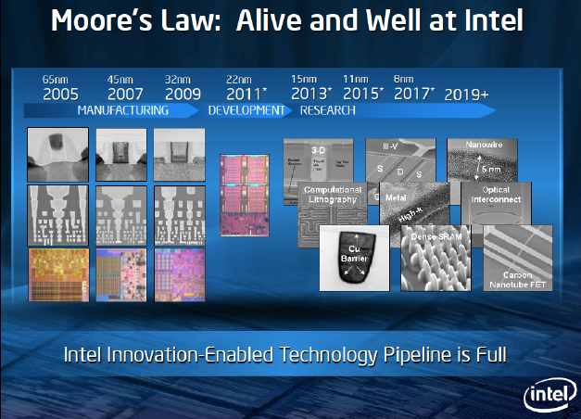
为什么学这门课
Study the structure of computer systems from the perspective of a computer scientist
To understand the basic Concepts, organization ,and design theory;
To understand the analysis and design methods of each part of computer system structure;
To know of the fundamental methods for the computer system design.
Improve coding.
Knowledge to make architectural choices.
体系结构领域仍然存在许多挑战性问题
例如：CPU与memory之间性能差异
功耗和能耗问题
体系结构与应用特征的适配性问题等
Explore the relationships between structure and function.
硬件怎样让软件运行的更快
软件怎样充分的使用硬件
更好地设计与实现操作系统、编译器
需要重新评估当前的假设和权衡.如: 当面临并行系统、异构系统日益普遍
现代计算机需要更好的优化编译器和更好的编程语言
Enable better systems: make computers faster, cheaper, smaller, more reliable, …
Enable new applications,e.g.Life-like 3D visualization ,Virtual reality,Personalized medicine?
Enable better solutions to problems
可更好地理解算法、数据结构和编程语言选择对性能的影响
Notes:
Intelligence Augmentation

Slide 25
为什么学这门课
Research on the concurrent processing technologies
pipelining technologies;
Concurrent processor technologies；
Multiprocessor technologies;
non Von Neumann computer architecture
…….
了解计算机的发展趋势
嵌入式系统
超级计算机
分布计算，普适计算
……

Slide 26
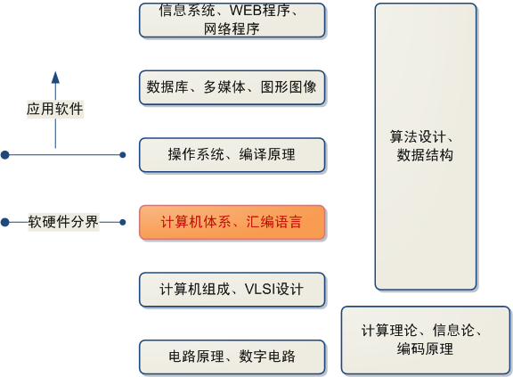
课程定位

Slide 27
与其他学科的交叉
学科交叉：计算机组成、操作系统、汇编语言、数据结构、微计算机技术、计算机网络、……
新内容：超标量处理机、超流水线处理机、VLIW处理机、向量处理机、并行处理机、多处理机、互连网络、……
计算机系统结构正处于变革时期
软件-系统结构-实现技术, 两头发展快中间慢
非冯计算机正兴起
系统结构的发展时期已经到来

Slide 28
本课程与其它课程的区别联系
与《计算机组成原理》的区别联系
《计算机组成原理》是一门以计算机系统基本工作原理为基础，结合逻辑分析、时序分析方法为一体的硬件分析与设计课程，重点在于弄清“怎样实现”。
《计算机体系结构》以计算机系统功能需求为基础，结合体系结构分析、设计方法、性能分析方法为一体的系统分析、设计与评估课程，重点在于弄清“为什么要这样实现”。
联系：
本门课程需要以计算机组成原理作为知识背景，只有对计算机实现的原理有了充分的理解，才能深入理解体系结构课程中所分析的主要内容。

Slide 29
与《数据结构、算法分析》的区别、联系
《数据结构、算法分析》以软件设计、分析为基础，结合数据结构、算法性能分析的方法为一体的软件分析、设计、评估课程。重点也在于“为什么要这样实现”。
体系结构以系统功能需求为出发点，重点分析计算机硬件的体系结构，兼顾软件模块的设计；数据结构以软件设计为出发点，主要是分析数据的组织方法、算法原理。
两门课程都是以“性能指标”作为评估标尺，性能分析是二者的共同点。这也是其中一些分析方法具有相似性的原因。
两门课程的讨论侧重点都在于“为什么要这样实现”，以相同性质的性能指标对不同的方法进行比较。

Slide 30
学习方法
掌握关键点
IS
IO的原理
存储层次
流水线等并行计算的原理
广泛学习相关知识
掌握计算机设计的原则
把握计算机发展的方向
认真完成实验和课外作业
阅读参考文献：参考书和参考材料很重要
学以致用，应用到编程和实践中
理论、技术与方法
如使用Intel编译器、混合编程等

Slide 31
Grading Schemes
What Do I Expect From You?
Learn the material thoroughly
attend lectures, do the readings, do the homeworks
Do the work & work hard
Ask questions, take notes, participate
Perform the assigned readings
Come to class on time
Start early – do not procrastinate
If you want feedback, come to office hours
Remember “Chance favors the prepared mind.” (Pasteur)
Homework 10%
Experimentation 10%
Class Attendance
and Interaction 10%
Presentation 10%
Final Exam(open) 60%

Slide 32
Tentative Class Schedule
Teaching Hours 32
Class hours 26
Experimentation(in/out) 6
Extra reading /design for the presentation and assignments

Slide 33
二、What’s Computer Architecture?
The science and art of designing, selecting, and interconnecting hardware components and designing the hardware/software interface to create a computing system that meets functional, performance, energy consumption, cost, and other specific goals.
描述计算机系统的功能、结构组织和实现的一组规则和方法。
计算机体系结构是软件设计者与硬件设备设计者（VLSI）之间的中间层，是软件与硬件的接口（Interface）

Slide 34
What’s Computer Architecture? (Cont.)
Computer Architecture is the design of the computer at the hardware/software interface
Computer Architecture = Instruction Set Architecture + Machine Organization
Computer Architecture
Instruction Set Design Machine Organization
Computer Interface Hardware Components
Compiler/System View Logic Designer’s View

Slide 35
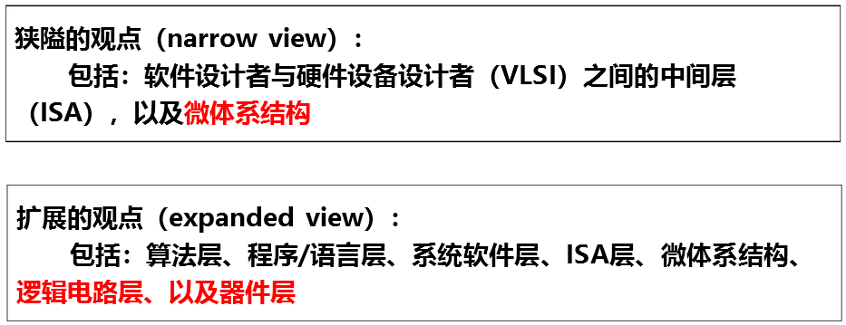
计算机体系结构的定义
传统的定义：
程序员可见的计算系统的属性。包括：概念性的结构和功能行为。不包括：数据流和控制流的组织、逻辑设计以及物理实现。 – Amdahl, Blaauw, and Brooks, 1964
Instruction-Set Architecture
广义的定义：
计算机体系结构研究如何 设计、组织，以及使用可用的生产技术实现信息处理系统，该系统可有效地执行软件应用，满足价格、功耗和性能约束, Includes ISA, microarchitecture, hardware
Notes:
Amdahl: IBM360系列机的主要设计者
Frederick P. Brooks, 曾任万国商用机器公司（即IBM公司或国际商务用机器公司）系统部主任，主持开发过OS/360等大型电脑（计算机）用的操作系统软体。后来，Brooks离开IBM公司进大学任教，并著书立说。
Gerrit Anne (Gerry) Blaauw (born July 17, 1924) is a Dutch computer scientist, known as one of the principal designers of the IBM System/360 line of computers, together with Fred Brooks, Gene Amdahl, and others.^{[1]}

Slide 36
计算机器件的发展
电子管、晶体管、IC（小、中、大、超大）、…
速度、性能、可靠性、集成度等均大幅度提高，成本降低
系统效率=min(器件速度)*min(系统结构效率)
例：1965~1975，器件速度提高10倍，系统效率提高100倍，系统结构提高100/10=10倍。
系统结构提高内容：以存储器为核心、虚拟存储系统、指令系统、并行访问存储器、中断、DMA、微程序设计等。
系统评价
评价内容：
功能、性能/价格
评价原则：
定性原则：根据系统的设计方法、采用技术进行分析、评价。
定量原则：通过大量模拟实验数据进行分析、评价。
评价时间：
设计过程中、设计完成后
评价方法：
分析、模拟和测量方法
定量原则比定性原则要精确得多。

Slide 37
计算机系统结构概念
基本定义：程序员所看到的计算机的属性，即概念性结构和功能特性。
问题：程序员的种类及对系统结构概念的影响？
系统结构精确定义？研究什么内容？
为什么要研究系统结构？好处是什么？
1.系统结构外特性--计算机系统的外观
（1）层次结构
多级层次结构图及含义。
转下页
Amdahl提出的体系结构：传统机器级的体系结构。
即一般所说的机器语言程序员所看到的传统器级所具有的属性。
经典计算机体系结构概念的实质：
计算机系统中软硬件界面的确定，其界面之上的是软件的功能，界面之下的是硬件和固件的功能。

Slide 38
管理系统的复杂性
In addition to abstraction and discipline, designers use the three "-y's" to manage complexity
hierarchy
modularity
and regularity.
These principles apply to both software and hardware systems.

Slide 39
应用
软件
应用语言级
L5虚拟机
翻译（应用程序包）
高级语言级
L4虚拟机
虚拟机器
翻译（编译程序）
系统
软件
汇编语言级
L3虚拟机
翻译（汇编程序）
操作系统级
L2虚拟机
部分解释
固件（Firmware）：指存储在计算机ROM等固定存储或其它集成电路中的系统软件，固件不能随意改变
软硬件交界面
固件
传统机器级
物理机器
实际机器
解释
硬件
微程序机器级
硬件直接执行
电子线路
不同级程序员所见系统属性不同。
问题：为何操作系统在层次结构中处于如此位置？
为高级语言的使用和实现提供所需的基本操作和数据结构（传统机器所没有的），它在许多机器上是经机器语言程序解释实现的。

Slide 40
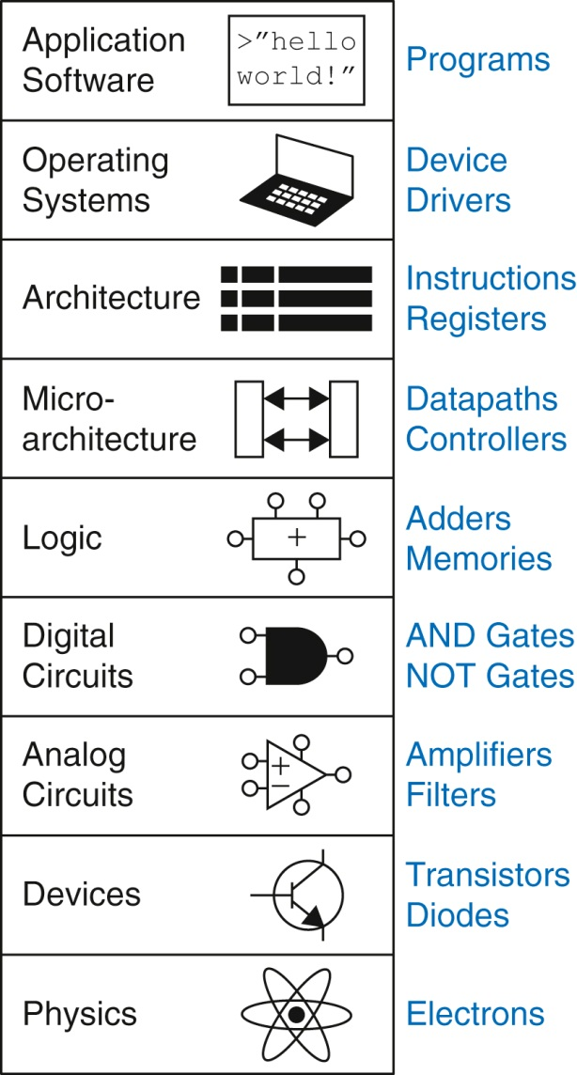
现代计算机系统的抽象层次
Application
Algorithm
Programming Language
Operating System/Virtual Machine
Instruction Set Architecture (ISA)
Microarchitecture
Gates/Register-Transfer Level (RTL)
Circuits
Devices
Physics
余腊生
版权所有，违者必究

Slide 41
The Power of Abstraction
Levels of transformation create abstractions
Abstraction: A higher level only needs to know about the interface to the lower level, not how the lower level is implemented
E.g., high-level language programmer does not really need to know what the ISA is and how a computer executes instructions
Abstraction improves productivity
No need to worry about decisions made in underlying levels
E.g., programming in Java vs. C vs. assembly vs. binary vs. by specifying control signals of each transistor every cycle
Then, why would you want to know what goes on underneath or above?

Slide 42
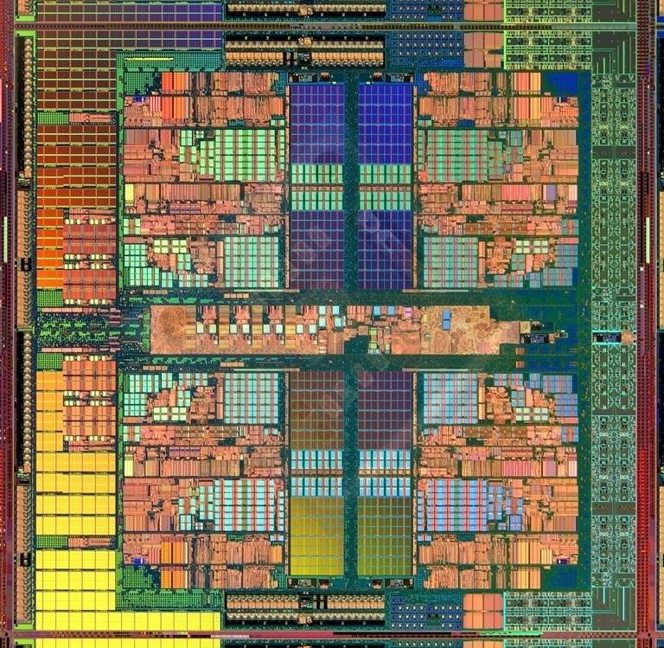
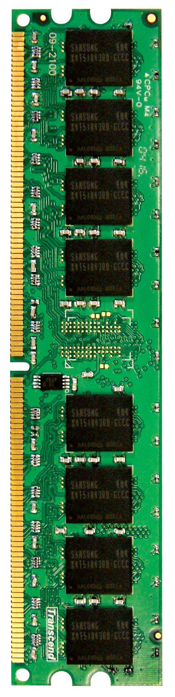
An Example: Multi-Core Systems
Multi-Core
Chip
CORE 0
L2 CACHE 1
CORE 1
L2 CACHE 0
SHARED L3 CACHE
DRAM INTERFACE
DRAM MEMORY CONTROLLER
DRAM BANKS
L2 CACHE 2
CORE 3
CORE 2
L2 CACHE 3
*Die photo credit: AMD Barcelona

Slide 43
Why the Disparity in Slowdowns?
to understand how a processor works underneath the software layer and how decisions made in hardware affect the software or programmer
Then to enable you to be comfortable in making design and optimization decisions that cross the boundaries of different layers and system components
Multi-Core
Chip
CORE 1
gcc
matlab
CORE 2
L2
CACHE
L2
CACHE
unfairness
INTERCONNECT
DRAM MEMORY CONTROLLER
Shared DRAM
Memory System
DRAM
Bank 0
DRAM
Bank 1
DRAM
Bank 2
DRAM
Bank 3
Notes:
-In a multi-core chip, different cores share some hardware resources. In particular, they share the DRAM memory system. The shared memory system consists of this and that.
When we run matlab on one core, and gcc on another core, both cores generate memory requests to access the DRAM banks. When these requests arrive at the DRAM controller, the controller favors matlab’s requests over gcc’s requests. As a result, matlab can make progress and continues generating memory requests. These requests are again favored by the DRAM controller over gcc’s requests. Therefore, gcc starves waiting for its requests to be serviced in DRAM whereas matlab makes very quick progress as if it were running alone.
Why does this happen? This is because the algorithms employed by the DRAM controller are unfair.
But, why are these algorithms unfair? Why do they unfairly prioritize matlab accesses?
To understand this, we need to understand how a DRAM bank operates.
Almost all systems today contain multi-core chips
Multi-core systems consist of multiple on-chip cores and caches
Cores share the DRAM memory system
DRAM memory system consists of
DRAM banks that store data (multiple banks to allow parallel accesses)
DRAM memory controller that mediates between cores and DRAM memory
It schedules memory operations generated by cores to DRAM
This talk is about exploiting the unfair algorithms in the memory controllers to perform denial of service to running threads
To understand how this happens, we need to know about how each DRAM bank operates

Slide 44
If You Are Interested … Further Readings
Onur Mutlu and Thomas Moscibroda, "Stall-Time Fair Memory Access Scheduling for Chip Multiprocessors" Proceedings of the 40th International Symposium on Microarchitecture (MICRO), pages 146-158, Chicago, IL, December 2007
Sai Prashanth Muralidhara, Lavanya Subramanian, Onur Mutlu, Mahmut Kandemir, and Thomas Moscibroda, "Reducing Memory Interference in Multicore Systems via Application-Aware Memory Channel Partitioning“,Proceedings of the 44th International Symposium on Microarchitecture (MICRO), Porto Alegre, Brazil, December 2011
Jamie Liu, Ben Jaiyen, Richard Veras, and Onur Mutlu,"RAIDR: Retention-Aware Intelligent DRAM Refresh“,Proceedings of the 39th International Symposium on Computer Architecture (ISCA), Portland, OR, June 2012. S
Onur Mutlu,"Memory Scaling: A Systems Architecture Perspective"Technical talk at MemCon 2013 (MEMCON), Santa Clara, CA, August 2013.
Kevin Chang, Donghyuk Lee, Zeshan Chishti, Alaa Alameldeen, Chris Wilkerson, Yoongu Kim, and Onur Mutlu,"Improving DRAM Performance by Parallelizing Refreshes with Accesses" Proceedings of the 20th International Symposium on High-Performance Computer Architecture (HPCA), Orlando, FL, February 2014. (pdf)
lides (pdf)

Slide 45
编译与解释
Recall
跨越不同层次级别的方法
基本概念（属于编译原理）
编译：全部N+1级指令 N级指令
解释：一条N+1级指令 一串N级指令
没有明显的界限
编译为整体行为，可以优化，高效率，往往与平台有关。
解释为局部行为，不优化，效率低，易于精确控制，与平台不直接相关。
编译和解释在现代语言实现中结合考虑
解释执行比翻译花的时间多，但存储空间占用较少。

Slide 46
分层带来的透明性
本来存在的事务或属性，从某个角度上看不到。
封装的结果
指令集、API等方式提供接口
在一个计算机系统中，低层机器的属性往往对高层机器的程序员透明
计算机组成设计的内容，对传统机器程序员来讲一般要求透明
余腊生
版权所有，违者必究

Slide 47
透明性的举例
传统机器级的概念性结构和功能特性
对高级语言的程序员-→透明
对汇编语言的程序员-→不透明
存储器采用交叉存取还是并行存取、CPU内部的数据通路的宽度(8位or16位)
对计算机系统结构-→透明
对计算机组成-→不透明
余腊生
版权所有，违者必究
Notes:
的。这说明高级语言的程序员不必知道机器的指令系统、中断机构等，这些本来存在的属性，对高级语言的程序员来说好象不存在一样，所以说是透明的。

Slide 48
分层分析的优点
有利于人们正确理解计算机系统的工作，明确软硬件和固件在计算机系统的地位和作用。
理解各种语言的实质及其实现。
有利于探索虚拟机器新的实现途径，便于设计新的系统。
有助于理解计算机体系结构的含义，从而合理地进行计算机系统的开发和设计。
余腊生
版权所有，违者必究

Slide 49
基于系统结构实际上是研究计算机系统中软、硬件之间的界面定义及其上下的功能分配与逻辑实现来看：
外特性含义
外特性精确定义：机器语言程序员或编译程序编写者所看到的计算机的外特性。
含义：计算机的概念性结构和功能特性。
外特性实际上定义了系统的软、硬件功能界面。
几个说明：
软、硬件功能在逻辑上是等价的。
某一功能既可用软件实现，也可用硬件实现。
方法不同，性能、灵活性、成本有所不同。
全硬件、软硬件结合、全软件
软、硬件功能分配可在很宽的范围内变化。
由性能与成本、可扩展性等因素决定。
透明性分析方法。
发展趋势
硬件实现的比例越来越高
硬件所占的成本越来越低
是进行软、硬件取舍的一种基本方法。

Slide 50
系统结构内特性--计算机系统的逻辑实现
定义：计算机系统的设计人员看到的基本属性，是外特性的逻辑实现。主要是如何合理地实现分配给硬件的功能。
包含内容：数据通路宽度、专用部件设计、各种OS共享程度、功能部件并行度、控制机构组成方式、排队与缓冲技术、预估与预判技术、可靠性技术等。
内、外特性关系
外特性：有关软件人员看到的系统基本属性；
内特性：系统设计人员看到的系统基本属性。
本课程侧重在计算机外特性的分析与设计上。
计算机实现
主要研究器件技术与微组装技术。

Slide 51
（4）三者之间关系
1 : n 1 : n
关系： 外特性 ----- 内特性 ----- 物理实现
关系举例：
外特性 内特性 实现
乘法功能 是否有乘法指令 乘法器/加法+移位 物理实现
主存系统 容量、编址方式 速度、措施 器件、电路
注意点：
系统结构设计不要对组成、实现技术的采用与发展有过多或不合理的限制；
计算机组成与实现是可以折衷权衡的；
三者的内容不同时期会有所变化。随着技术的发展，三者关系融合于一体，难以分开。
系统结构的设计与硬件的设计不可混淆。
Notes:
为什么要研究系统结构？好处是什么？

Slide 52
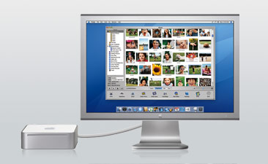

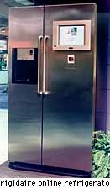
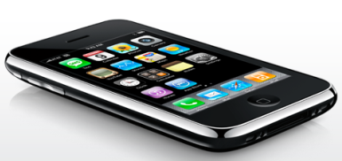
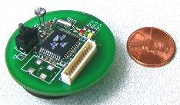

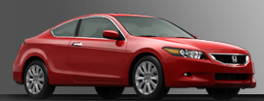

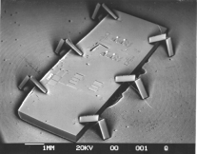
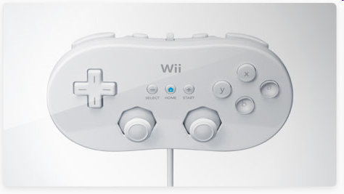
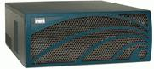


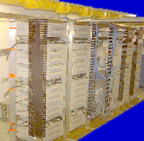
Computing Systems Today
The world is a large parallel system
Microprocessors in everything
Vast infrastructure behind them
Massive Cluster
Clusters
Gigabit Ethernet
Internet Connectivity
Scalable, Reliable,
Secure Services
Databases
Information Collection
Remote Storage
Online Games
Commerce
…
Refrigerators
Sensor Nets
Cars
MEMS for
Sensor Nets
Routers
Robots
Notes:
Micro-Electro-Mechanical System

Slide 53
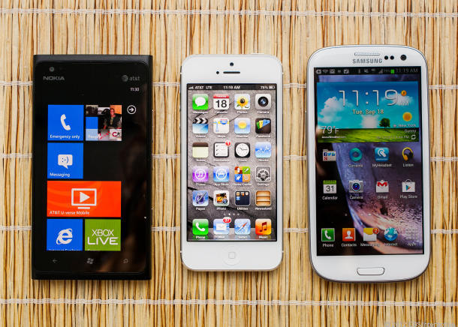

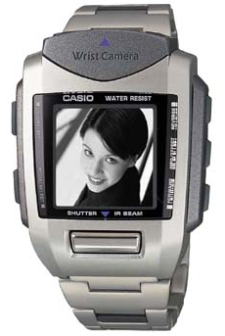
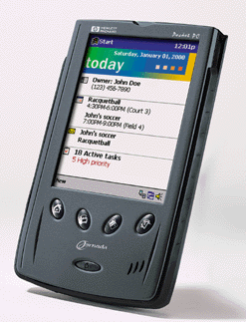
New “Great Ideas”
Personal Mobile Devices
Wearable
computer
Pocket PC
Wrist PC

Slide 54
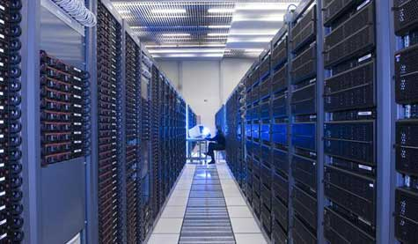

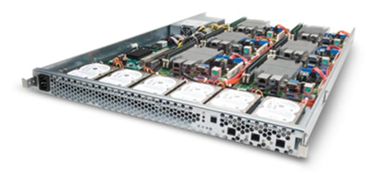
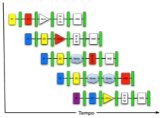
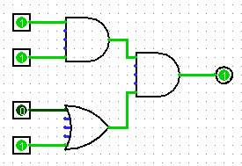
New “Great Ideas”
Software Hardware
Parallel Requests
Assigned to computer
e.g., Search “Katz”
Parallel Threads
Assigned to core
e.g., Lookup, Ads
Parallel Instructions
>1 instruction @ one time
e.g., 5 pipelined instructions
Parallel Data
>1 data item @ one time
e.g., Add of 4 pairs of words
Hardware Descriptions
All gates functioning in parallel at same time
Programming Languages
Warehouse Scale Computer
Smart Phone
Leverage Parallelism &
Achieve High Performance
Computer
Core
…
Core
Memory
Input/Output
Core
Instruction Unit(s)
Functional
Unit(s)
A₀+B₀
A₁+B₁
A₂+B₂
A₃+B₃
Cache Memory
Logic Gates

Slide 55
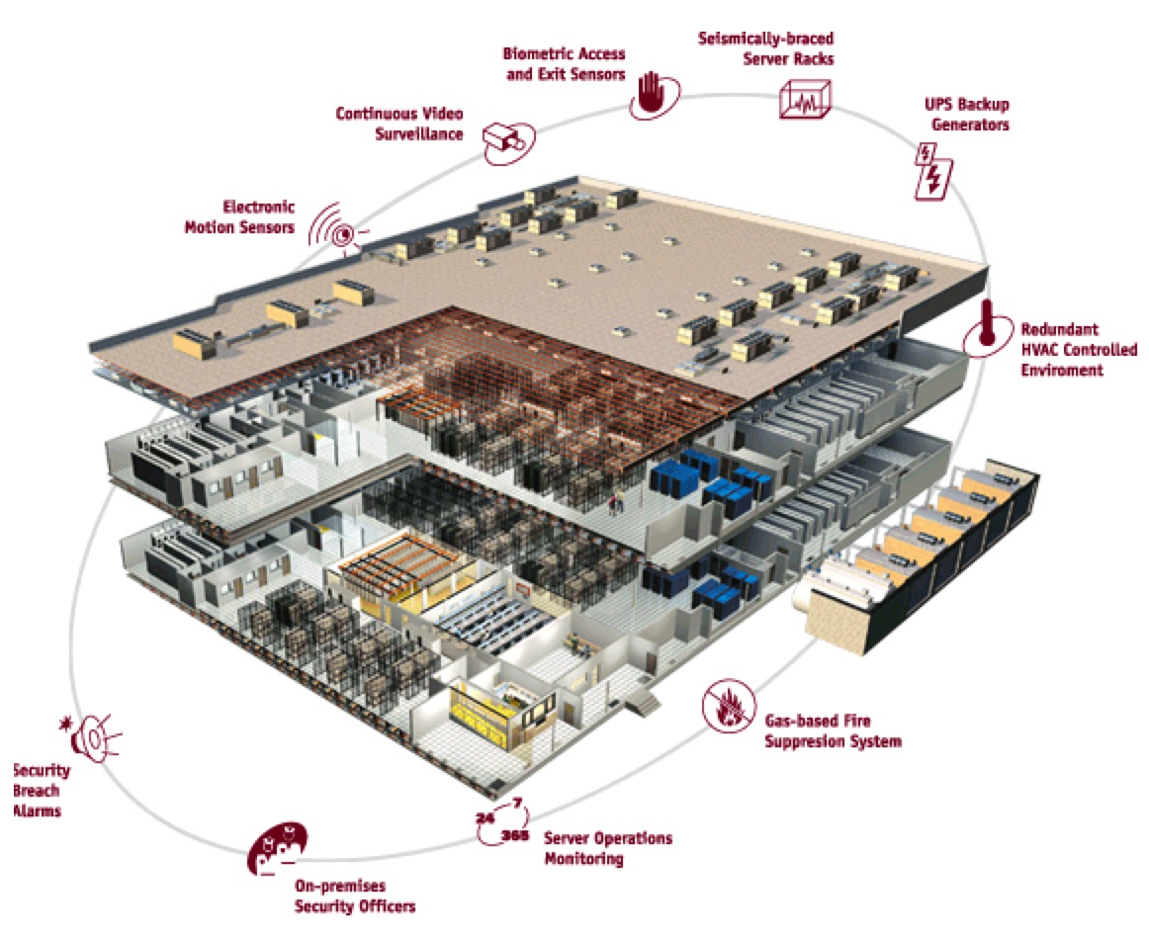

Warehouse
Scale
Computer
Notes:
供暖通风与空气调节(Heating Ventilation and Air Conditioning)
seimsmically braced server racked
抗震支撑服务器

Slide 56
What is Ahead?
Bigger caches. More levels of cache? Software control.
Greater instruction level parallelism?
Increased exploiting data level parallelism:
Vector and Subword parallel processing
Exploiting task level parallelism: Multiple processor cores per chip; how many are needed?
Bus based communication, or
Networks-on-Chip (NoC)
Complete MP Systems on Chip: platforms
Compute servers
Cloud computing

Slide 57
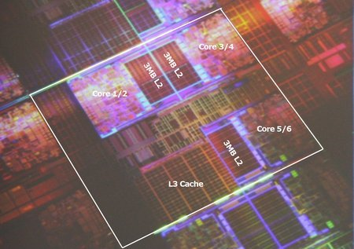
Intel Dunnington 6-core

Slide 58
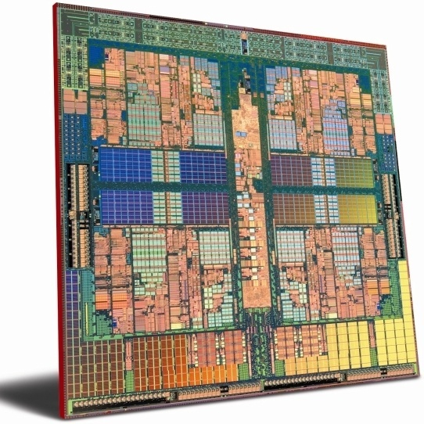
AMD Hydra 8 core
45 nm
L2: 1MByte/core
L3: shared 6MByte

Slide 59

Intel MIC: many integrated core architecture, aka Intel Xeon Phi
2015 version : Knights Landing
build on Silvermont (Atom) x86 cores with 512-bit (SIMD) AVX units
up to 72 cores / chip => 3 TeraFlops
14 nm
using Micron’s DRAM 3D techn. (hybrid memory cube)

Slide 60

Tianhe-2: performance nr 1 in 2014
3.120.000 cores
33.8 PetaFlop
17.8 MegaWatt

Slide 61


2016年世界最快的计算机
神威太湖之光
这套系统1分钟的计算能力，相当于全球72亿人同时用计算器不间断计算32年；如果用2016年生产的主流笔记本电脑或个人台式机作参照，‘太湖之光’相当于200多万台普通电脑。

Slide 62



2018年世界最快的计算机 -- SUMMIT
由4608台计算服务器组成，每个服务器包含两个22核Power9处理器（IBM生产）+ 6个Tesla V100图形处理单元加速器（NVIDIA生产）。
PB级的异构存储系统:含10PB的存储器+快速、高带宽，实现有效的数据传输。
运算速度：20亿亿次(200PFlops) Summit是Titan的8倍，相当于普通笔记本电脑运算速度的100万倍，比 “神威⋅太湖之光”峰值性能（每秒12.5亿亿次）快约60%。
为提高I/O吞吐量，使用Mellanox公司的双轨InfiniBand EDR连接以无阻塞胖树架构互联。

Slide 63

当前的主流应用模式：云、管、端
云: 大型的数据中心，企业私有云（仓储式计算机）
管：网络。主干光纤网，接入网，局域网，无线网（在网络中路由器、交换也大量用到处理器）
端：手机、平板、桌面、可穿戴装置、传感器
其他模式
超算中心：超级计算机（紧耦合集群）
边缘计算：利用终端的计算能力，去中心化结构
网络就是计算机
The Network is the Computer!

Slide 64


2018天猫11.11的云计算历史上最高的云访问率
2135亿/天交易额｛全国最大的百货商场北京王府井一年139亿，平均一天0.38亿｝
在这一天，一个天猫相当于5600个王府井百货商场
交易创建峰值: 40.5万笔/秒
支付成功峰值：32.6万笔/秒
阿里云运用的是什么样的计算机结构？
仓储式计算机（大规模集群结构）

Slide 65







云的范例：阿里张北云中心简介
项目计划总投资200亿元，占地630亩，容纳30万台服务器规模（三个点互为备份，阿里张北云联数据中心、阿里张北数据港数据中心和阿里中都草原数据中心），用于京津冀地区的云服务
计算机系统结构 ：仓储式计算机（大规模松耦合集群机，每个点10万台服务器）
采用阿里自研“飞天操作系统”
采用水冷和风冷相结合，能耗效率PUE1.25
机器人故障和环境监测
供电：电网+太阳能+风能
已建杭州、青岛、北京、香港、深圳中心

Slide 66



端的范例：华为推出的手机 Mate20的 处理器：麒麟980
六项世界第一
领先工艺：全球最早商用TSMC 7nm工艺的手机SoC芯片，69亿颗晶体管
NPU（ Neural Network Processing Unit） ：首款搭载双核NPU（寒武纪AI内核的优化版）的移动端芯片（图像识别，语音识别，用户行为分析）
CPU：全球实现基于ARM Cortex-A76 CPU架构（2个超大核、2个大核和4个小核）进行商业开发
GPU：首款搭载最新的Mali-G76 GPU架构的移动端芯片（用于图像处理，游戏流畅）
通信升级：通信方面率先支持LTE Cat.21，峰值下载速率1.4Gbps达业内最高
内存升级：内存方面支持全球最快的LPDDR4X颗粒，主频最高可达2133MHz
国外竞争对手
苹果A12处理器（7nm)
华为在性能上仍与苹果有差距；
高通骁龙855处理器（7nm)
2018年8月30日德国IFA大会华为发布新的手机处理器

Slide 67



ACM2017图灵奖授予 两位计算机系统结构大师
RISC
无所不在的处理器大部分绝大部分是RISC
NPU来源于DSA，
TPU
RISC，
RAID，
NOW
（集群的最初来源）
TPU

Slide 68
思考题
1、简要描述你对计算机体系结构这一概念的理解。
2、请根据你的理解阐述计算机体系结构和计算机
组成原理这两门课程主要的差异在哪里？
3、我们需要为计算市场设计什么？
4、What a computer Architecture designer need to know ?
➢

Slide 69
二、计算机体系结构的分类
1 按处理机性能分类
便携机
手持式终端（PDA、MP3、手机）
1) 按大小划分
种类：巨型、大型、中型、小型、微型机
工作站介于小型机和微型机之间，具有小型机的性能，微型机的价格。
划分原则：以性能为特征，按价格来划分
设计方法：最高性能 特殊用途
最佳性能价格比 一般商用计算机
最低价格 家用计算机等
2) 按用途划分
种类：科学计算、事务处理、实时控制、工作站、服务器、家用计算机等。

Slide 70
计算机用途的分类
个人移动设备 (PMD)
智能手机、平板电脑
ARM-ISA兼容的通用处理器芯片（SoC: System on Chip ）在市场上处于统治地位
SoC中包含大量的专用加速器 (radio, image, video, graphics, audio, motion, location, security, etc.)
强调能效和实时性(energy efficiency and real-time)
桌面计算（Desktop Computing）
强调性价比(price-performance)
服务器（Servers）
强调可用性、可缩放性、吞吐率(availability, scalability, throughput)

Slide 71
计算机用途的分类（续）
集群/仓储级计算机（Clusters / Warehouse Scale Computers）
每个数据中心包含10+万个处理器核
X86-ISA兼容的服务器芯片在市场上占统治地位
专门的应用程序，加上虚拟机的云托管
现在越来越多地使用gpu、fpga和定制硬件来加速工作负载
其分支: Supercomputers：强调浮点运算性能和高速内部互联
强调可用性和性价比(availability、price-performance、energy)
嵌入式计算机/物联网（Embedded Computers / Internet of Things）
有线/无线网络基础设施，打印机
消费类产品( TV/Music/Games/Automotive/Camera/MP3)
物联网（Internet of Things!)
强调价格、能耗及面向特定应用的性能(Emphasis: price、energy、application-specific performance)

Slide 72

五类主流计算系统特点
Figure 1.2 A summary of the five mainstream computing classes and their system characteristics. Sales in 2015 included about 1.6 billion PMDs (90% cell phones), 275 million desktop PCs, and 15 million servers. The total number of embedded processors sold was nearly 19 billion. In total, 14.8 billion ARM-technology-based chips were shipped in 2015. Note the wide range in system price for servers and embedded systems, which go from USB keys to network routers. For servers, this range arises from the need for very large-scale multiprocessor systems for high-end transaction processing.

Slide 73
3) 按数据类型划分
定点计算机、浮点计算机、向量计算机、堆栈计算机等
4) 按处理机个数和种类划分
单处理机
并行处理机、多处理机、分布处理机
关联处理机
超标量处理机, 超流水线处理机, VLIW处理机
SMP(对称多处理机)、MPP(大规模并行处理机)、机群(Cluster)系统等

Slide 74

补充：系统结构中的并行性
并行性概念与分级
并行性概念：在同一时刻或同一时间间隔内完成两种或两种以上工作，只要在时间上相互重叠，均存在并行性。
分类：
同时性－－指两个或多个事情在同一时刻发生的并行性
并发性－－指两个或多个事情在同一时间间隔内发生的并行性
并行性等级
指令内部并行，即指令内部的微操作之间的并行；
指令间并行，即并行执行两条或多条指令；
任务级或过程级并行，即并行执行两个或多个过程或任务（程序段）（任务分解）；
作业或程序级并行，即在多个作业或程序间的并行（并行算法）。

Slide 75
Parallelism
Classes of parallelism in information process:
存储器操作并行（并行存储器系统、相联处理机）
处理器操作步骤并行（流水线处理机）
处理器操作并行（阵列处理机）
指令、任务、作业并行 （多处理机）
Classes of architectural parallelism:
Instruction-Level Parallelism (ILP)
Vector architectures/Graphic Processor Units (GPUs)
Thread-Level Parallelism
Request-Level Parallelism

Slide 76
Architecture: Increase in Parallelism
1985年以前位级(4-8-16位)并行（Bit level parallelism）
32-bit 处理器后性能提升变慢
90年代采用64-bit 、128-bit 及更高位 通过向量处理提高性能
重大的拐点：32位处理器和缓存适合一个芯片
80年代中到90年代后期主要发展指令级并行（Instruction Level Parallelism）
流水线、RISC、编译技术的进步→ 挖掘指令级并行
片上cache及功能部件的增加-> 超标量执行
更精巧的技术: 乱序执行和硬件投机执行
现状：线程级并行和片上多处理器（thread level parallelism and chip multiprocessors）
线程级并行超越了指令集并行
在单个芯片中部署多个处理器及互联结构
在处理器芯片内多个线程并行执行

Slide 77
提高并行性的技术途径
时间重叠（time-interleaving）
并行性概念中引入时间因素，即多个处理过程在时间上相互错开，轮流重叠使用同一套硬件的各个部件，以加快部件的周转而提高速度。
资源重复（resource-replication）
并行性概念中引入空间因素，根据以数量取胜原则，重复设置硬件资源以大幅度提高计算机系统的性能。
资源共享（resource-sharing）
利用软件方法，使多个用户分时使用同一个计算机系统。例如多道程序、分时系统就是资源共享的产物。

Slide 78
并行处理的耦合
耦合度是反映多机系统中各机器之间物理连接的紧密程度和交互作用能力的强弱
最低耦合：仅通过中间存储介质互相通信，除此之外，各机器间并无物理连接，也无共享的联机硬件资源 。例如：磁带
松散耦合（间接耦合）：机器之间是通过通道或通信线路实现互联，共享某些外围设备。特点：通信频带较低
紧密耦合（直接耦合）：通过总线或高速开关实现互连，共享主存储器，机器间通信频率高，信息传输率和吞吐量大。

Slide 79
多机系统的耦合度

Slide 80
MIMD的分类
Notes:
PVP（parallel vector processor）
CC-NUMA(coherent-cache nonuniform menory access)
NORMA(No-Remote Memory Access)非远程存储模型
SMP:称为共享存储型多处理机(Shared Memory mulptiProcessors), 也称为对称型多处理机（Symmetry MultiProcessors)。
UMA:称为均匀存储器存取（Uniform-Memory-Access)
NUMA：非均匀存储器存取（Nonuniform-Memory-Access） MPP (Massively Parallel Processing)
COMA：只用高速缓存的存储器结构（Cache-Only Memory Architecture）
ccNUMA：高速缓存相关的非一致性内存访问（CacheCoherentNon-UniformMemoryAccess）

Slide 81
多机系统
同构型多处理机是把一道程序（作业）分解为若干相互独立的程序段或任务，分别有各个处理机并行执行。
异构型多处理机是将作业分解成串行执行的若干个任务，分别有不同功能的处理机分工完成，依靠流水作业的原理，对多个作业重叠地进行处理。
分布处理系统各处理机尽量完成本地作业，当其资源和能力不够时才与其他处理机协同。

Slide 82
5) 按所使用的器件划分
按使用的器件划分计算机系统的时代
第一代：电子管(Valve)计算机
第二代：晶体管(Transistor)计算机
第三代：集成电路(LSI)计算机
第四代：大规模集成电路(VLSI)计算机
第五代：智能计算机？
目前的绝大部分计算机系统是VLSI计算机
公认的第五代计算机什么时候诞生？
第五代计算机以什么作为标志来划分？

Slide 83
五代计算机的特征表
第一代
1945~1954
电子管
继电器
存储程序计算机
程序控制I/O
机器语言
汇编语言
普林斯顿ISA、ENIAC、IBM701
第二代
1955~1964
晶体管、磁芯
印刷电路
浮点数据表示、寻址技术、中断、I/O处理机
高级语言、编译、批处理监控程序
Univac LARC、CDC 1604
IBM 7030
第三代
1965~1973）
多层印刷电路
微程序
流水线、Cache、先行处理、
系列机
多道程序
分时操作系统
IBM 360/370
CDC 6600/7600
DEC PDP-8
第四代
1974~1990
LSI、VLSI
半导体存储器
向量处理
分布式存储器
并行和分布处理
Cray-1、IBM 3090
DEC VAX 9000
Convax-1
第五代
1990~
高性能微处理器
高密度电路
具有人工智能的新一代计算机
超标量、超流水、SMP、MP、MPP，。。。
在现在的智能社会中，计算机、网络、通信技术会三位一体化
大规模、可扩展并行与分布处理，。。。
SGI Cray T3E
IBM（模拟人脑神经元、突触功能以及其他脑功能的微芯片
）、SP2、DEC
AlphaServer 8400

Slide 84

Closer Look at Processor Technology
特征尺寸不断减小（feature size ），芯片集成度不断提高
电路的速度在不断提高
芯片的面积在不断增加
主频在提高 ( 功耗成为问题)
单位面积的晶体管数量在增加
性能每10年提高100倍
时钟频率提高了10倍
DRAM 的密度每3年提高4倍
如何使用这些晶体管?
Parallelism in processing: 有更多的功能部件
每个时钟周期并行多个操作降低了CPI
Locality in data access: 更大的Cache
降低了访存的延时从而降低了CPI，提高了处理器的利用率

Slide 85
2 按“流”分类：Flynn分类法
1966年由Michael. J. Flynn提出。三个重要概念：
1）模型中的重要概念
指令流（Instruction Stream）：机器执行的指令序列；
数据流（Data stream）：由指令处理的数据序列；
多倍性（Multiplicity）：在系统最窄的部件上，处于同一执行阶段的指令和数据的最大可能个数。
2）模型中的基本模块
MM（Memory Module）：内存模块。
PU（Process Unit）：处理单元
CU（Control Unit）：控制单元

Slide 86
3）按照指令流和数据流的多寡，Flynn将计算机体系结构分成4种类型：
⑴ 单指令流单数据流（SISD——Single Instruction Single Data stream）
一个CU从MM串行读取每一条指令，每一条指令串行的控制一个PU对MM串行的读取、写入数据。
IS
IS
DS
模块间的操作均为串行的，只能通过在各模块（CU、PU、MM）内部建立流水线机制提高操作的并行程度，并行操作仅限于模块内部。
例子：目前大多数的微型计算机。
CU
PU
MM
( a ) SISD
Flynn分类法各类结构的概念性框图
CU：控制部件； PU：处理部件； MM：存储器模块； IS：指令流； DS：数据流

Slide 87
⑵ 单指令流多数据流（SIMD——Single Instruction Multiple Datastream）
一个CU从MM串行的读取每一条指令，每一条指令控制多个PU从MM并行的读取、写入多个数据。
IS
PU₁
DS₁
MM₁
一个CU，多个PU、多个MM，CU与MM间为单连接，PU与MM间为多连接。
PU与MM间的的操作为并行的，CU与MM间的操作为串行的。模块内部也可以实现流水线提高并行操作程度。
CU
IS
PU₂
DS₂
MM₂
DS_{n}
PU_{n}
MM_{n}
( b ) SIMD
Flynn分类法各类结构的概念性框图
例子：在这种结构的机器上实现向量运算的指令（注意，不是向量计算机），在SISD结构上的实现的软件循环结构在一定程度上可能消失或得到缓解。
CU：控制部件； PU：处理部件； MM：存储器模块； IS：指令流； DS：数据流

Slide 88
⑶ 多指令流单数据流（MISD——Multiple Instruction Single Datastream）
多个CU从MM并行的读取多条指令，这些指令同时控制多个PU对从MM串行读取的每个数据进行处理，最终串行的把每个数据写回MM。
CU、PU、MM均为多个，CU与MM间为多连接，但是PU与MM间为单连接。
PU与MM间的操作为串行的，CU与MM间的操作为并行的。各模块内部可使用流水线提高内部操作并行度。
IS₁
DS
CU₁
PU₁
MM₁
IS₁
IS₂
IS₂
CU₂
PU₂
MM₂
IS_{n}
DS
IS_{n}
CU_{n}
PU_{n}
MM_{n}
例子：实际应用中没有这种体系结构的计算机系统，MISD目前仅具有理论意义。
把CPU内部的流水线机制理解为MISD结构是牵强的，因为MISD是同时读取多条指令，而流水线则是指进行取指令、分析指令、执行指令等各部件的并行工作方式。
( c ) MISD
Flynn分类法各类结构的概念性框图
CU：控制部件； PU：处理部件； MM：存储器模块； IS：指令流； DS：数据流

Slide 89
没有MISD计算机的原因之一：通常PU用于处理简单数据，一般没有多个简单数据需要一组相同处理的需求。没有存在的需求基础。
没有MISD计算机的原因之二：如果把PU用于处理复杂数据（向量、矩阵等），一方面MISD已经变成了MIMD，另一方面，相对于SIMD性能价格比较低。
MISD适合于多条指令处理一个复杂数据的应用，但是通常单个PU只能处理简单数据，否则PU的复杂度、PU与MM连接的复杂度都将会大幅度提高。

Slide 90
没有MISD计算机的原因之三：适合MISD实现的应用都可以使用其它结构实现，没有存在的必然性。因为任何复杂数据都可以分解为简单数据。
第一，可以使应用变为单条指令处理单个简单数据的应用，这种应用可以使用SISD结构。
第二，可以使应用变为单条指令处理一组简单数据的应用，这种应用可以使用SIMD结构。
到目前为止，在MISD结构上实现的应用，如果改在SISD、SIMD结构上实现，都能达到同样或更高的性能/价格比。

Slide 91
⑷ 多指令流多数据流（MIMD——Multiple Instruction Multiple Datastream）
多个CU同时从多个MM中读取多条指令，这些指令同时控制多个PU从MM中读取多个数据、同时处理数据、写回数据。
特征：
多个CU、多个PU、多个MM，且各类模块间的连接是多连接。
各类模块间的操作全部都是并行的。
例子：多机系统。
IS₁
DS₁
CU₁
PU₁
MM₁
IS₁
IS₂
DS₂
CU₂
PU₂
MM₂
IS₂
IS_{n}
DS_{n}
CU_{n}
PU_{n}
MM_{n}
IS_{n}
( d ) MIMD
Flynn分类法各类结构的概念性框图
CU：控制部件； PU：处理部件； MM：存储器模块； IS：指令流； DS：数据流

Slide 92
Flynn分类法得到广泛应用
SIMD、MIMD、SPMD、XIMD、…
主要缺点：
(1)分类太粗
在SIMD中包括有多种处理机
对流水线处理机的划分不明确，
标量流水线为SISD，向量流水线为SIMD
(2)根本问题是把两个不同等级的功能并列对待
数据流受指令流控制，造成MISD不存在
(3)非冯计算机的分类？其他新型计算机的分类

Slide 93
3 库克分类法
1978年由 D. J. Kuck提出 按控制流和执行流分类，四种类型
(1)单指令流单执行流
SISE(Single Instruction Single Executionstream)
典型的单处理机
(2)单指令流多执行流
SIME(Single Instruction Multiple Executionstream)
多功能部件处理机、相联处理机、向量处理机、
流水线处理机、超流水线处理机、超标量处理
机、SIMD并行处理机
(3)多指令流单执行流MISE
(Multiple Instruction Single Execution stream)
多道程序系统
(4)多指令流多执行流MIME
(Multiple Instruction Multiple Execution stream)
典型的多处理机
主要缺点
有些系统，如分布处理机等，没有总控制器
分类级别太低，没有处理机级和机器级
分类太粗，如SIME中包含了多种处理机

Slide 94
4 、按“最大并行度”分类：冯氏分类法
1972年，美藉华人冯泽云提出以最大并行度作为系统结构分类的标准。
所谓最大并行度Pm是指一个系统在单位时间内能够处理的最多的二进制位数，显然这是一个完全由计算机硬件结构决定的参数。
最大并行度的数值越大越好。

Slide 95
位片宽（m）
位片宽：处理机个数
16384
MPP
(1,16384)
288
STARAN
PEPE
256
(1,256)
(32,288)
ILLIAC-Ⅳ
64
(64,64)
32
Cmmp
TI-ASC
16
(64,32)
(16,16)
EDVAC
PDP-11
IBM 370/168
1
(1,1)
(16,1)
(32,1)
字宽（n）
1
16
32
64
字宽：处理机字长
图1-5 冯氏分类法对计算机的划分
⑴ 字串位串（WSBS）：n = 1，m = 1。这是最早期全串行运算的计算机。
⑵ 字并位串（WPBS）：n > 1，m = 1。这是传统的并行单处理机。
⑶ 字串位并（WSBP）：n = 1，m > 1。每处理机只一位，但有许多个处理机字并行运用，如STARAN，MPP，DAP等。
⑷ 字并位并（WPBP）：n > 1，m > 1。PEPE，ILLIAC Ⅳ，Cmmp等计算机属此类。
W – Word；B – Bit；S – Serial；P – Parallel。

Slide 96
计算机并不能总是处在最大并行度下工作，实际并行度与所执行的程序有关。→提出一个平均并行度的概念。
如果在一个时钟周期Δt_{i}内实际处理的二进制位数为P_{i}，那
么在T个时钟周期内的平均并行度P_{a}就为：
把平均并行度与最大并行度之比称为平均利用率，用μ
表示为：

Slide 97
5 按“并行级”和“流水线”分类：Händler表示法
此方法根据计算机可并行和流水处理的程度，将硬件分成三个层次：
⑴ 程序控制部件（PCU）的个数k；
⑵ 算术逻辑部件（ALU）或处理部件（PE）的个数d；
⑶ 每个算逻部件包含基本逻辑线路（ECL）的套数w。
每一个计算机系统都可以用上述三个参数表示其结构特征，即：
t（系统型号）=（k，d，w）。
为了更细致的反映结构特殊性，表示式可写成：
t（系统型号）=（k×k’，d×d’，w×w’），
其中：k’表示宏流水线中程序控制部件的个数；
d’表示指令流水线中算术逻辑部件的个数；
w’表示操作流水线中基本逻辑线路的套数。
各层次的数值越大越好。

Slide 98
几种分类标准的共同特征：分析计算机系统的并行操作程度，并按并行度进行分类。
如果综合使用多种分类标准，可以得到细致的分类结果。

Slide 99
6、按控制方式分类
类型： （4种）
控制流方式：顺序执行 （冯·诺依曼型）
数据流方式：操作数到位即可运算，无序执行↓
规约方式： 驱动方式与数据流相反，无序执行↑
匹配方式： 非数值型应用，主要对象为符号。
对不同类型结构，并行程度越大越好。
7、按系统结构风格分类
系统结构风格：
一些合理的、已有确切说明的特征、特性。
类型：
面向堆栈型、面向寄存器型、面向对象型等。

Slide 100
第二节 系统结构设计
一、计算机系统设计思路
1.由上向下方法
适合于专用机的设计，从应用到实现级，周期几年。
缺点：当应用对象或范围变化时，效率急剧下降。
原因：软、硬件脱节，不能利用最新的软件技术。
2.由下向上方法
前提：硬件不能改变。
缺点：易形成软、硬脱节，软件不能获得最新硬件的支持，结果软件繁杂、效率低。

Slide 101
3.从中间开始方法
从软、硬件交界面开始设计。
要求首先进行软、硬件功能分配，同时
考虑硬件能为软件提供什么支持。
优点：避免软、硬件脱节，设计周期短，有利于优化设计。
缺点：对设计人员要求较高，要求具有有效的软件设计环境和开发工具，便于分析、评价和设计。
此方法引发了计算机系统结构的研究，并很快占有主导地位。

Slide 102
二、系统结构的设计步骤
1.需求分析
主要在应用环境、所用语言的种类及特性、对OS的特殊要求、所用外设特性、技术经济指标、市场分析等方面。
2.需求说明
主要包括设计准则、功能说明、器件性能说明等。
3.概念性设计
进行软、硬件功能分析，确定机器级界面。
4.具体设计
机器级界面各方面的确切定义，可考虑几种方案。
5.反复进行优化设计及评价

Slide 103
Already known how to define, measure and summarize performance, then we can explore some of the principles and guidelines in design and analysis of computers.
三、 Quantitative Principles of Computer Design
Take Advantage of Parallelism
Focus on the Common Case
Amdahl’s Law (or Gustafson's Law)
E.g. common case supported by special hardware; uncommon cases in software
Principle of Locality
The Performance Equation

Slide 104
Parallelism
How to improve performance?
(Super)-pipelining
Powerful instructions
MD-technique
multiple data operands per operation
MO-technique
multiple operations per instruction
Multiple instruction issue
single instruction-program stream
multiple streams (or programs, or tasks)

Slide 105
Principle of Locality
Important fundamental observations come from the properties of programs.
Principle of locality: Programs tend to reuse data and instructions they have used recently.
There are two different types of locality: (Ref. Chapter 5)
Temporal Locality (locality in time): If an item is referenced, it will tend to be referenced again soon (loops, reuse, etc.)
Spatial Locality (locality in space/location): If an item is referenced, items whose addresses are close one another tend to be referenced soon (straight line code, array access, etc.)
We can predict with reasonable accuracy what instructions and data a program will use in the near future based on its accesses in the past.
A program spends 90% of its execution time in only 10% of the code.
Last 30 years, HW relied on locality for memory perf.
Notes:
The principle of locality states that programs access a relatively small portion of the address space at any instant of time.
This is kind of like in real life, we all have a lot of friends. But at any given time most of us can only keep in touch with a small group of them.
There are two different types of locality: Temporal and Spatial. Temporal locality is the locality in time which says if an item is referenced, it will tend to be referenced again soon.
This is like saying if you just talk to one of your friends, it is likely that you will talk to him or her again soon.
This makes sense. For example, if you just have lunch with a friend, you may say, let’s go to the ball game this Sunday. So you will talk to him again soon.
Spatial locality is the locality in space. It says if an item is referenced, items whose addresses are close by tend to be referenced soon.
Once again, using our analogy. We can usually divide our friends into groups. Like friends from high school, friends from work, friends from home.
Let’s say you just talk to one of your friends from high school and she may say something like: “So did you hear so and so just won the lottery.”
You probably will say NO, I better give him a call and find out more.
So this is an example of spatial locality. You just talked to a friend from your high school days. As a result, you end up talking to another high school friend. Or at least in this case, you hope he still remember you are his friend.
+3 = 10 min. (X:50)

Slide 106
➔Memory Hierarchy Levels
Capacity
Access Time
Cost
Staging
Xfer Unit
CPU Registers
100s Bytes
300 – 500 ps (0.3-0.5 ns)
Registers
Upper Level
Instr. Operands
prog./compiler
1-8 bytes
faster
L1 and L2 Cache
10s-100s K Bytes
~1 ns - ~10 ns
~ $100s/ GByte
L1 Cache
Blocks
cache cntl
32-64 bytes
L2 Cache
cache cntl
64-128 bytes
Main Memory
G Bytes
80ns- 200ns
~ $10/ GByte
Blocks
Memory
Pages
OS
4K-8K bytes
Disk
10s T Bytes, 10 ms (10,000,000 ns)
~ $0.1 / GByte
Disk
Files
user/operator
Gbytes
Larger
Tape
infinite
sec-min
~$0.1 / GByte
Tape
Lower Level
still needed?

Slide 107
Focus on the Common Case
Favor the frequent case over the infrequent case
E.g., Instruction fetch and decode unit used more frequently than multiplier, so optimize it first
E.g., If database server has 50 disks / processor, storage dependability dominates system dependability, so optimize it first
Improving the frequent event, rather than the rare event, will obviously help performance
Frequent case is often simpler and can be done faster than the infrequent case
E.g., overflow is rare when adding 2 numbers, so improve performance by optimizing more common case of no overflow
May slow down overflow, but overall performance improved by optimizing for the normal case
We have to decide what the frequent case is and how much performance can be improved by making the case faster
=> Amdahl’s Law

Slide 108
Amdahl’s Law
Amdahl’s Law states that the performance improvement to be gained from using some fast mode of execution is limited by the fraction of the time the faster mode can be used.
Amdahl’s Law defines the speedup that can be gained by using a particular feature.
Speedup due to enhancement E:
This fraction enhanced
Fraction_{enhanced}: the fraction of the execution time in the original machine that can be converted to take advantage of the enhancement
Speedup_{enhanced}: the improvement gained by the enhanced execution mode

Slide 109
Amdahl's Law
Fraction_{enhanced}
ExTime_{new} = ExTime_{old} x (1 - Fraction_{enhanced}) +
Speedup_{enhanced}
ExTime_{old}
ExTime_{new}
1
Speedup_{overall} =
=
Fraction_{enhanced}
(1 - Fraction_{enhanced}) +
Speedup_{enhanced}
This fraction enhanced
ExTime_{old}
ExTime_{new}

Slide 110
例1-1：设改进后的某部件运行速度是原速度的10倍，而该部
件原运行时间占全系统运行时间的比例为40%，那么此项改
进会使全系统的性能得到多少提升？
解：按照Amdahl定律，系统性能的提升可以用加速比表示。
据题意：F_{e} = 0.4；Re = 10，直接使用公式，可得：
利用对加速比的计算，可以决定提高全系统性能的努力应该从
何处入手，即花较小的代价，获取较大的效益。

Slide 111
例1-2：在测试计算机浮点运算性能的基准测试程序中，浮点运算
指令FP操作时间占全部时间的60%，其中求浮点平方根的指令
FPSQR占全部运行时间的20%。为了提高全系统的性能，可以考虑
两种改进方案。一是采用FPSQR硬件，将FPSQR运算速度提高10
倍；另一个是加快全部浮点运算速度，使FP指令的执行速度提高
2倍。试比较这两种方案的优劣。
解：分别计算两种方案所能得到的加速比
显然，提高整个浮点运算速度对全系统的性能提高更好些。

Slide 112
例1-３：一个专门用以对CPU的多媒体处理性能进行测试的基准
程序，其中用于对多媒体信息运算的时间占全部运算时间的70%。
由于处理机对多媒体的处理能力不强，特别对一些实时信息的处
理更是不能容忍。请寻求提高处理机多媒体处理能力的方案，并
进行评估和比较。
解：首先分析一下多媒体信息处理的特点。多媒体信息处理
中，大量的是对数组的运算，即同样的运算要对许多数据反复进
行操作。按照传统的流水线方法必须使用许多次的循环，浪费掉
大量的CPU时间。
需要改进的模块：CPU中的多媒体处理模块
模块的原子操作 ：多媒体处理模块所执行的多媒体指令

Slide 113
一、 提高CPU的时钟频率，即减小CPI。
这是最直接能想到的方案，但在实现上比较困难。
实用的考虑：体系结构设计者所作的工作不是进行元件级别的设计，但是可以选择元件，如果市面上没有所要求的元件或者价格太贵，则应考虑放弃这种方案；
除非有实现元件级别改进的配套设备，否则不应该考虑开发新的元件。
二、 将CPU的流水线条数增加为n，理想情况下其运行速度可以提高n倍。
因为速度相差太大，需要增加的流水线数目也相当大。
一方面会给工艺上带来极大的困难，甚至达到不可能制作的地步（体系结构受到元件发展的限制）。
另一方面如果流水线条数太多，指令的分配和调度也会带来许多困难，使实际效果大打折扣（得不偿失）。

Slide 114
三、设计专门的多媒体指令及处理硬件，大幅度提高同一条指
令处理大量数据的能力。
使多媒体指令全部由这个特定的部件处理，其余指令仍由原
流水线处理。两个部件处于并行方式下运行，程序在该CPU上的
运算时间由两个部件中较慢的那个部件决定。
如果多媒体部件对多媒体信息的处理能力提高了10倍，系统
的加速比应为：
从式中可以看出，加了一个多媒体部件后系统加速比的大小
与多媒体指令所占的比例有关，所占比例越高，系统加速比越大。
前两种方案失败的原因：除了元件的限制外，忽略了2：8原则，没有考虑重点解决多媒体部件的性能提高，而是考虑从全局角度解决局部问题；把“局部问题，全局评估”歪曲为“局部问题，全局解决”。

Slide 115

Amdahl's law

Slide 116

Gustafson's law
Gustafson proposed a change to Amdahl's law
He assumes the data (input) set for the parallel part scales (increases) linearly with the number of processors => much better scaling
Speedup = n - F_{seq}(n-1) where n is number of processors (parallel speedup), F_{seq} = sequential fraction of the original program

Slide 117

Gustafson's law

Slide 118
The performance equation
The CPU Performance Equation
Essentially all computers are constructed using a clock running at a constant rate
CPU time then can be expressed by the amount of clock cycles
Main performance metric:
Total Execution Time
T_{exec} = N_{cycles} * T_{cycle}
= N_{instructions} * CPI * T_{cycle}
CPI: (Average number of) Cycles Per Instruction

Slide 119
Example: Calculating CPI
Base Machine (Reg / Reg)
Op Freq Cycles CPI(i) (% Time)
ALU 50% 1 .5 (33%)
Load 20% 2 .4 (27%)
Store 10% 2 .2 (13%)
Branch 20% 2 .4 (27%)
1.5
Typical Mix

Slide 120
四、软、硬件取舍原则
1.现有软、硬件条件下，选择能够提高系统性能/价格的方法；
2.考虑到准备采用和可能采用的组成技术，所选方法能否尽量不限制组成和实现技术；
3.不能仅从“硬”的角度去考虑如何便于应用组成技术的成果和发挥器件技术的进展，还应考虑所选方法能否从“软”的角度为编译和操作系统的实现，以至高级语言程序的设计提供更多更好的硬件支持。

Slide 121
正确结论
结论
某个功能是经常使用的基本单元，适宜用硬件实现
计算机系统（或者部件）的产量需求大，增大硬件实现的比例是适宜的
软硬件结合的系统设计
硬件需要软件支持和配置
软件需要硬件提升速度
Notes:
单纯的硬件不可能完成复杂的应用程序工作

Slide 122
第三节 计算机性能标准
一、衡量计算机性能的主要标准
计算机性能：正确性、可靠性和工作能力。
评价性能：仅指工作能力。
工作能力指标：
处理能力—单位时间内能处理的信息量(吞吐率)。
响应能力—响应时间、周转时间、排队时间。
利用率—T时间内，某部分被使用时间t与T的比值。

Slide 123
1．CPU的能力
⑴ 硬件连接能力（主要是指速度指标）
CPU通过在引脚上设置数据、地址和控制总线实现与外部电路的连接，这种能力的强弱常用数据总线带宽，即单位时间内传输的数据量来表示。这是一个速度指标。
地址总线的宽度可以衡量CPU支持的容量指标。
控制总线的数量、性质可以衡量CPU的功能、可靠性、可扩展性等指标，但表达可能比较复杂。

Slide 124
1）数据带宽
CPU引脚中数据总线的宽度乘以总线传输速率得到数据带宽。（注意，由CPU、系统总线共同决定）
例如，数据总线的传输速率为266 MHz，总线的宽度为32位（4字节），那么该数据总线的带宽就达到2.1GB/s（266MHz×4B）。
显然，数据总线带宽越宽，表明该处理机对其他部件的读写速度越快。
体系结构改善：提高总线传输速率、增加总线宽度，相应的增加成本。

Slide 125
2）CPU与Cache连接方式
随着处理机工作速率的提高，采用Cache（高速缓冲存储器）是提高CPU工作效率的必备措施，而与Cache的连接方式也成为考察处理机连接能力的又一个重要方面。
CPU在片内连接Cache比在片外连接Cache具有更高的速度指标。
CPU与Cache之间的数据通道越多，则速度越快。

Slide 126
一级CACHE集成在CPU同一芯片内。
二级一般也在CPU同一芯片内(全速CACHE),有的在芯片外,但与CPU 在同一专用板上且有专门通道与CPU相连。
有的CPU还提供专门通道连结第三级CACHE。
体系结构改善：为CACHE设计足够宽的通道、尽量把Cache设计在CPU芯片内，但是这会相应增加制造难度和成本。

Slide 127
⑵ 管理能力（可靠性、速度、容量、可扩展性、性能价格比）
由于现代微处理机上集成了许多过去只有在大型机的中央处理机中才有的特性，所以管理能力也成为一个引人注目的方面。
其中对存储器的管理、对多道作业的管理、中断管理及对多处理机工作的管理能力尤其值得关注。
可靠性：多道作业管理
速度：Cache寻址，中断管理
容量：虚拟存储器寻址
可扩展性：中断管理
性能价格比：操作系统中某些软件功能放在硬件中实现，提高系统整体的性能价格比。

Slide 128
Recall :CPU Performance(Response)
the CPU time for a program is given by:
Or,
alternative method to get the CPU time
CPU performance is equally dependent upon 3 characteristics: clock cycle time, CPI, Instruction Count (IC). They are independent and making one better often makes another worse because the basic technologies involved in changing each characteristics are interdependent.
Clock cycle time: hardware technology and organization: VLSI
CPI: organization and instruction set architecture
IC: instruction set architecture and complier technology

Slide 129
CPU Performance
Example: Suppose we have 2 implementations of the same instruction set architecture. Computer A has a clock cycle time of 10 nsec and a CPI of 2.0 for some program, and computer B has a clock cycle time of 20 nsec and a CPI of 1.2 for the same program.
What machine is faster for this program?
Answer
Assume the program require IN instructions to be executed:
CPU clock cycle_{A} = IN x 2.0
CPU clock cycle_{B} = IN x 1.2
CPU time_{A} = IN x 2.0 x 10 = 20 x IN nsec
CPU time_{B} = IN x 1.2 x 20 = 24 x IN nsec
So computer A is faster than computer B.
系统响应能力能反映计算机系统的软、硬件性能。

Slide 130
CPU时间是可从某个程序执行中得到的，且指令数也与具体程序有关。显然，如果在同一个处理机上运行不同的程序，所得的CPI也可能是不同的。所以，作为衡量CPU运行速度的指标CPI，通常是一种概率统计的结果。
假定通过许多程序的统计，得知第i类指令的使用概率为P_{i}，而执行该类指令所需的时钟周期数为CPI_{i}，而全部指令的类别数为n，该处理机的统计平均CPI 就为：
（1-2）
如何提高系统性能？
减小平均CPI
↓
减小频繁使用（Ii/IN较大) 指令的CPI
↑大概率事件优先原则的应用

Slide 131
例：假定某CPU的主频为500MHz，据统计，其各类指令使
用的概率和执行所需时钟数列出在下表中，请确定该处理机每
条指令的平均执行时间。
指令类型 出现概率（%） 执行周期数
加法、减法、移位 20 1
取数、存数 40 2
乘法、除法 5 3
浮点加、浮点减 20 5
中断 10 5
输入、输出 5 10
解：根据式（1-2）可知
CPI = 0.2×1 + 0.4×2 + 0.05×3 + 0.2×5 + 0.1×5 + 0.05×10 = 3.15
每条指令平均执行时间T = 3.15×2ns = 6.3ns
这种CPI计算方法的有效性前提：每种指令在程序设计中使用的概率必须尽量统计准确。

Slide 132
例： A机执行的程序中有20%转移指令(2TC)，转移指令都需要一条比较指令(1TC)配合，其他指令1TC。B机中转移指令包含比较指令，但TC比A机慢15%。A机、B机哪个工作速度快？
A机：TCPUA=INA×(0.2 × 2+0.2 × 1+0.6 × 1)×TCA
=1.2 INA× TCA
B机：TCPUB=0.8INA×((0.2/0.8) × 2+(1- 0.2/0.8) × 1)
×1.15TCA
=1.15 INA× TCA
结果：B机比A机工作速度快。
注意：不能仅按主频衡量系统性能。
思考：根据CPI指标的计算，思考RISC设计思路。

Slide 133
二、 系统运行速度/系统处理能力
CPI的含义：以CPU为评估的模块，以指令系统中各条指令被执行的概率（频度）为依据，以平均每条指令所花费的时钟周期数标尺，对CPU的速度进行评估。
但是如果以计算机系统整体作为一个被评估的模块，CPI显然是不合适的。
通常用MIPS和MFLOPS反映系统（CPU）吞吐率。

Slide 134
Measurement Tools
Benchmarks, Traces, Mixes
Hardware: Cost, delay, area, power estimation
Simulation (many levels)
ISA, RT, Gate, Circuit level
Queuing Theory (analytic models)
Rules of Thumb
Fundamental “Laws”/Principles

Slide 135
Marketing Metrics
MIPS =Instruction Count / (Time * 10^6) = (Frequency / CPI) / 10^6
Not effective for machines with different instruction sets
Not effective for programs with different instruction mixes
Uncorrelated with performance
MFLOPs = (FP Operations / Time) / 10^6
Machine dependent
Often not where time is spent
Peak - maximum able to achieve
Average - for a set of benchmarks
Relative - compared to another platform
Normalized MFLOPS:
add,sub,compare,mult 1
divide, sqrt 4
exp, sin, . . . 8

Slide 136
1．MIPS和MFLOPS
⑴ MIPS（Million Instruction Per Second），被称为每秒百万条指令，只适宜于评估标量机。
从定义式可以看出，系统的MIPS数值越大，表明其运行速度也越快。
该指标的缺陷：
只是反映了当前指令系统的前提条件下，指令执行的速度，不能反映指令的含金量，即不能反映指令系统本身的效率。
例1：A系统1秒钟执行了100条指令，完成了应用程序TEST的全部功能，程序执行完毕；B系统1秒钟执行了1000条指令，完成了应用系统10%的功能，程序还没执行完。
还不如直接使用应用程序总的执行时间来进行比较。
没有考虑测试的全面性，如果没有一组用于测试的标准测试程序，那么该指标是没有可比性的。

Slide 137
例2. A系统运行TEST1程序时，总共花费10秒，平均每秒执行100条指令；A系统运行TEST2程序时，总共花费100秒，平均每秒执行1000条指令。究竟应该以哪一个程序的测试结果为准？
例3. 两个系统生产厂商对各自的系统进行速度指标评估，A系统的厂商使用TEST1程序作为测试程序，因为它能使A系统的MIPS指标达到最高；B系统的厂商采用了同样的手段。
用户应该如何选择？
对系统整体速度进行评估时，指标的改善：
1）应采用反映程序执行总共时间作为量化指标，而不是指令的执行速度。
2）在确定的系统功能限定下，应对各种类型的程序均作同等的测试，并对量化指标进行综合评估，而不是单一的测试某一个程序。

Slide 138
⑵ MFLOPS（Million Floating Point Operations Per Second），
被称为每秒百万次浮点运算。
一个系统的MFLOPS数值越大，意味着在单位时间内运行的浮点运算越多。这个指标把浮点运算理解为指令执行的主要功能。
该指标和MIPS指标具有类似的缺陷，留在课后分析。
MFLOPS比较适宜于评估向量计算机。
相同程序在不同机器上，指令数不同，但浮点数操作个数会相同。故对浮点运算而言，MFLOPS比MIPS更精确。
MFLOPS与MIPS关系：1MFLOPS≈3MIPS。

Slide 139
MIPS、MFLOPS指标具有缺陷的根本原因：
“执行指令”是哪一个模块的原子操作？
CPU
如果把计算机系统整体看作一个模块，它的原子操作是什么？
“执行程序”
CPU与系统整体的关系是怎样的？
CPU是计算机系统的一个核心子模块。
缺陷的根源：原子操作理解错误，把子模块的原子操作理解为当前模块的原子操作。

Slide 140
2．基准测试程序
针对MIPS、MFLOPS指标缺乏标准测试程序这一缺陷（原子
操作理解错误引起），提出了基准测试程序的概念。
基准测试程序通常用高级语言编写，由各系统自带的编译程
序编译成适合在本机中运行的机器码，记下各程序运行所化
费的时间，然后按一定的规则计算其执行时间。
基准测试程序通常可以分为两类：
（1）一类用于测试系统中所用的元部件，如CPU（针对指令
系统测试）、硬盘（针对IO操作测试）等，
（2）另一类则用来对全系统的性能进行测试（针对程序测
试）。

Slide 141
基准测试程序套件
SPEC(http://www.spec.org/)
Standard Performance Evaluation Corporation
SPEC2017，同时SPEC2000也在维护
桌面基准测试程序
Winstone (测试windows下的PC)
服务器测试程序
事务处理（TP）基准程序www.tpc.org
Processor Throughput-oriented benchmarks (基于SPEC CPU benchmarks->SPECrate
SPECSFS, SPECWeb
嵌入式系统测试程序
很多，比如EEMBC(Embedded Microprocessor Benchmark Consortium www.eembc.org)

Slide 142
一些专门的性能指标测试程序
3DMark03
主要测试显卡性能和DirectX的性能。
Prime95
用来估计分布式计算程序的通信情况，可使计算机高负荷运转，所以也用来测试计 算机的稳定性。
SuperPi/SuperE
计算圆周率π/自然指数e的软件，通常用来测试CPU的稳定性。

Slide 143
⑴ SPEC（Standard Performance Evaluation Corporation）
是由一些工作站生产商发起成立的标准性能评估联合体的简称，是基准程序测试方面影响最大的一个组织。 SPEC测试方法不仅能用于评估速度指标，它同样能用于对其它性能指标进行评估。
SPEC基准测试程序对于测试结果的处理可以分为两个方面。
1）一方面是对每个测试程序的运行结果给出一个衡量标准，
2）另一方面是对全部测量结果给出一个总体评价。
作为衡量单个测试程序运行结果的一种方法，早期是将一个基准程序在DEC公司的VAX 11/780（一种超级小型机）上运行所需时间定为SPEC参考时间。其他机器运行的时间与这个参考时间相比，得到一个SPEC速率，借以表现一个系统对该程序运行时的相对速度。
例如，SPEC程序集中有一个gcc程序，他的SPEC参考时间为1482秒，如果另一个系统运行同样程序所化的时间为100秒，那么这个机器的SPEC速率就是14.82。

Slide 144
在考虑整个基准程序集的测试结果时，SPEC推荐使用几
何平均值作为标准。即：
优势： 在对各种机器性能进行比较而进行性能规格化（即以某台机器性能作参考标准,其它机器性能除以该参考标准所得到的比值）过程中,不论取哪一台作参考机,几何平均值均能保持比较结果的一致性.
SPEC数的优点：各个测试程序的测试结果在综合评估中受重视的程度相同，具有公平的比较原则。
SPEC数的缺点：不能反映系统分析的侧重点，如果用户选择的只是某一类型程序的速度指标，则无法依据SPEC数进行选择。
SPEC数适用的场合：对某个功能领域内的计算机进行对等的速度指标评估，能够保证综合评估的公平性，不侧重任何一个子功能。

Slide 145
Pentium4性能评测数据 （数据全部来源于Intel网站）

Slide 146
⑵ iCOMP（Intel Comparative Microprocessor Performance）是Intel公司在1993年为对自己生产的各种微处理机进行比较而设定的一个相对性能，其表现形式是一个简单的数字，称为iCOMP指数。
在iCOMP测试方法中，设定了一个基准数，即以一个程序在
486SX-25处理机上的运行得分为100。被测CPU在运行相应的
程序后，也得到一个分值，然后按一定的规定加权，从而计
算出全部测试程序运行后所得的iCOMP指数。
计算公式如下：
iCOMP = 100×[(Mark₁ / Base-Mark₁) P₁ + … + (Mark_{n} / Base-Mark_{n}) P_{n}]
式中，Mark_{n}为被测CPU在运行第n个测试程序时的得分，符号Base-Mark_{n}为第n个程序在486SX-25上运行时的得分， P_{n}为第n个测试程序在整个测试中的权重。

Slide 147
iCOMP指数的优点：能够对不同的测试程序设定不同的权重，由此决定综合评估的侧重点，能够很好的适应不同用户的需求。
iCOMP指数的缺点：不能对各个系统给出公平的综合评估指标，因为由某个公司确定的权重参数可能只对它自己有利；如果有各个公司自行确定权重，则它们只会尽量侧重各自系统中性能比较优越的子功能。
iCOMP指数适用的场合：用户在根据自己的需求选购系统时，进行有侧重的综合评估。
同样，iCOMP指数可以用于评估各种性能指标，而不只是速度指标。

Slide 148
小结
系统整体的原子操作是“执行程序”，以此为基础的系统整体速度指标才具有合理性。
MIPS、MFLOPS这两个指标具有先天性的缺陷。
SPEC数和iCOMP指数是实用的系统综合评估指标，SPEC数适用于官方的系统性能比较或性能指标发布；iCOMP指数适用于用户根据自己需求进行的侧重评估，二者取长补短，缺一不可。
SPEC数和iCOMP指标不仅可以用于评估系统的速度指标，而且可以用于评估其它的指标。

Slide 149
三、利用率
虽不直接表示系统性能指标，但与前两种指标有密切关系。对系统性能或结构改进与优化起着至关重要的作用。
例：对CPU、主存、I/O通道、I/O设备的优化等。
应用：利用阿姆达尔定律和程序局部性原理改进来提高部件利用率。
注意：
对上述三个性能指标，由于测试作业(程序)具有较大的随机性，所得结果应用概率分布（平均值和标准偏差值）来描述。
Notes:
如何对评价结果进行统计与比较？

Slide 150
四、性能评价技术（自学）
目的：可用于开发中和开发后的系统评价。
种类：分为分析、模拟和测量三种。
1.分析技术
方法：在一定假设条件下，计算机系统参数与性能指标参数之间存在着某种函数关系，按其工作负载的驱动条件列出方程，用数学方法求解。
近似求解算法：聚合法、均值分析法、扩散法等。
2.模拟技术
按被评价系统的运行特性建立系统模型；
按系统可能有的工作负载特性建立工作负载模型；
用语言编写模拟程序，模仿被评价系统的运行；
设计模拟实验，依照评价目标，选择与目标有关因素，得出实验值，再进行统计、分析。

Slide 151
3.测量技术
只能对已投入使用的系统进行测量，通常采用不同层次的基准测试程序评估。
评估层次：有实际应用程序、核心程序、合成测试程序三个层次。但必须均为国际性组织认可的程序。
如何保证评估结果的准确性？
对评估结果进行分析和统计。
性能评价结果有峰值性能和持续性能两种。
持续性能最能体现系统的实际性能。通过多组(n)程序进行测试后统计。如果考虑工作负荷中各个程序出现的比例不同，可将各程序的执行速度或执行时间的加权。
算术性能平均值
几何性能平均值
归一化执行时间特性：Gm(X_{i})/Gm(Y_{i})=Gm(X_{i}/Y_{i})
调和性能平均值

Slide 152
五、多机系统性能评价
除采用单机的评价方法外，还需测试系统的性能加速比和性能可伸缩性值。
1.性能加速比
P问题大小，n处理机数，h为通信开销。
注意：为减少误差，T(p,1)应选择最优串行算法，而非并行算法分散化方法。
2.性能可伸缩性
对一个给定的应用问题，系统性能随PE数增加而线性增长的性能。
影响因素：PE数，时钟频率，问题大小，求解时间等。
评价方法：
选择某参考机作为比较参照机，测量后得出性能可伸缩性值。
参照机不同，所得结果不同。可通过概率分布等方法统计和评价结果。

Slide 153
第四节 计算机系统结构发展
• 体系结构发展历史
– Mainframes,
*A New Golden Age for Computer Architecture:
Domain-Specific Hardware/Software Co-Design,
Enhuanced Security, Open Instruction Sets, and Agile
Chip Development
– Minicomputers,
– Microprocessors
John Hennessy and David Patterson
June 4, 2018
– RISC vs CISC，VLIW
• 体系结构现状及挑战
– Denard Scaling 及 Moore’s Law 的终结
– Security
• 体系结构发展机遇
– Open Architectures
– Domain Specific Languages and Architecture
– Agile Hardware Development

Slide 154
体系结构发展历史
• 产品应用方面
– PC/Server => IoT, Mobile/Cloud
• 集成电路技术方面
– 登纳德缩放比例定律的终结：功耗成为关键制约条件
– Moore定律的终结：晶体管的集成度提高延缓
• 体系结构方面
– 挖掘指令级并行性方面的限制和低效，04年结束了单处理器时代
– Amdahl定律暗示了简单多核时代的结束

Slide 155
一、冯·诺依曼机组系统结构的演变
1.组成
由运算器、控制器、存储器、I/O设备组成。
2.特点 also called stored program computer
采用存储程序原理
指令串行执行，由控制器控制
存储器按地址访问，是顺序的一维线性空间
使用机器语言，数据以二进制表示
单处理机结构，以运算器为中心
输入输出设备与存储器之间的数据传送都途经运算器

Slide 156
3.缺点
两个瓶颈：CPU—存储器，指令串行执行
机器语言与高级语言间语义差别较大
复杂数据结构必须经过地址映象存放
4.改进
方法：改良方法、革命方法。
总线结构，分散控制
改良方法：
程序运行中不允许被修改
采用先行控制、流水线等方法，开发并行性
采用多体交叉存储器，增加存储带宽
增加新的数据表示，进一步支持高级语言
以存储器为核心，使I/O设备和CPU可并行工作
输入/输出方式

Slide 157
总线结构，分散控制
总线： 连接计算机各功能部件的连线和管理信息传输规则的逻辑电路称为总线。
特点：在任何时刻，只能有一个部件向总线上发送信息，可以有多个部件同时接收信息。
组成： 数据总线、地址总线、控制总线。
单总线结构
总线
输入
设备
输出
设备
CPU
主存

Slide 158
双总线结构
处理机总线
CPU
主存
32MHz
32或64位
扩展总线
控制线路
ISA / EISA
8.33MHz
8、16、32位
I/O设备
I/O设备
. . . . .

Slide 159
三总线结构
处理机总线
主存
CPU
100MHz
32或64位
PCI桥
PCI BUS
33MHz 4B
接快速设备
I/O设备
I/O设备
扩展总线
控制线路
ISA / EISA
8.33MHz
8、16、32位
接慢速设备
I/O设备
I/O设备
. . . . .

Slide 160
分布的I/O处理能力
以运算器为中心带来了慢速输入／输
出操作占用快速运算器的问题。
为了解决这一问题，人们提出了各种
输入/输出方式。

Slide 162
非冯计算机的发展
什么是非冯计算机？非指令驱动，…
从传统的指令驱动型改变为数据驱动型，出现了数据流机计算机。
从传统的指令驱动型改变为需求驱动型，出现各种图归约计算机。
处理非数值化信息的智能计算机，自然语言、声音、图形和图象处理,虚拟现实处理等
第五代计算机，由推理机和知识库机等组成。历经10年，召开过多次专题国际会议。
神经网络计算机，仿生计算机，…

Slide 163


非冯体系结构--类脑计算
异构多核虽然受到脑功能分区的启发，但仍然是图灵机原理
而类脑计算是一种非图灵机模式
模仿大脑神经元的互联，靠连接记忆来处理信息，目前还在研究阶段，没有商用化

Slide 164




典型类脑芯片
IBM Truenorth芯片
每个核都简化模仿了人类大脑神经结构，包含256个“神经元”（处理器）、256个“轴突”（存储器）和64000个突触（神经元和轴突之间的通信）。总体来看，TrueNorth芯片由4096 个内核，100 万个 “神经元”、2.56 亿个 “突触” 集成。此外，不同芯片还可以通过阵列的方式互联。
清华忆阻器类脑芯片
英特尔神经拟态芯片Loihi
IBM Truenorth芯片
浙大“达尔文”类脑芯片

Slide 165
二、软件、应用和器件对系统结构的影响
1.软件对系统结构发展的影响
主要体现在软件可移植性问题。
（1）统一高级语言方法
实现方法：采用同一种不依赖于任何具体机器的高级语言编写系统软件和应用软件。存在一定的困难，至今还没有这样一种高级语言，短期内很难实现。C、Ada、Java、……争取汇编语言或机器语言的统一。
导致开放系统（具有可移植性、交互操作性）的出现，用硬件抽象层技术适应不同的硬件平台。
（2）系列机思想
通过统一或扩展机器语言来实现软件可移植性。
系列机思想使得新的组成与实现技术很快得到应用，大量的兼容产品出现，推动了系统结构的发展。

Slide 166

IBM 360 （1964年）
系列中各机型(规模由小到大，功能从弱到强，包括20、30、40、50、65、75等6个型号，后来扩充了25、85、91、195等型号)具有兼容性

Slide 167
表 PC系列机典型特性比较
处理器
8088
80286
80386
80486
Pentium
Pentium II
Pentium III
Pentium 4
计算机
PC和PC XT
PC AT
80386 PC
80486 PC
Pentium PC
Pentium II PC
Pentium III PC
Pentium 4 PC
时间
1981
1982
1985
1989
1993
1997
1999
2000
字宽
16位
16位
32位
32位
32位
32位
32位
32位
存储空间
20位
24位
32位
32位
32位
32位
32位
32位
主要操作系统
DOS
DOS、XENIX
DOS、Windows 3.0
DOS、Windows 3.1
DOS、Windows 3.1
Windows 95
Windows 98、2000
Windows Me、XP
主要I/O总线
PC总线
AT（ISA）
ISA/EISA
ISA+VL
ISA+PCI
ISA+PCI+AGP
PCI+AGP +USB
PCI-X+AGP +USB

Slide 168
相同的指令系统，采用顺序执行、重迭、流水和并行处理方式
相同的32位字长，数据通路宽度为8位、16位、32位、64位。
如PC系列机有：
不同主频：4.7MHz，500MHz，1GHz，2.4GHz, 3GHz, …
不同扩展：Pentium、Pentium Pro、Pentium MMX、Pentium SSE、Pentium SSE2
不同Cache：Pentium、Celeron、Xeon
不同字长：8位、16位、32位、64位
采用系列机方法的主要优点：
(1) 系列机之间软件兼容，可移植性好
(2)在统一数据结构和指令系统的基础上，便于组成多机系统和网络；
(3)插件、接口等相互兼容
(4) 便于维修、培训
(5) 有利于提高产量、降低成本
采用系列机方法的主要缺点：
限制了计算机系统结构的发展
如PC系列机，其系统结构非常落后，使用也最普及

Slide 169
兼容机：具有相同系统结构或对原系统结构进行扩充，不同组成或实现技术，其性能不一定比系列机差。
影响：为保持软件兼容性，系列机要求系
统结构基本不变，又限制了系统结构的发展。
软件兼容种类：向上/下、向前/后兼容。
机器档次
高
向上兼容
当前机器
向下兼容
低
向前兼容
向后兼容
时间
系列机要求：保证向后兼容，力争向上兼容。

Slide 170
（3）模拟与仿真
系列机能实现程序移植，其原因在于系列机有相同的系统结构。如果要求程序能在具有不同系统结构的机器间相互移植，就要求做到在某系统结构之上实现另一种系统结构，即实现另一种机器的属性。
仿真是用微程序直接解释另一种指令系统。其解释程序在微程序存储器同时还需解释操作系统、I/O系统的操作。B的一条机器指令用A的一段微程序去解释执行
模拟用机器语言解释实现软件移植,其解释程序在主存储器。同时模拟机器语言、存储系统、I/O系统、控制台操作及形成虚拟操作系统。 B的一条机器指令用A的一段机器语言程序去解释执行
优缺点比较
模拟方法速度低，仿真方法速度高
仿真需要较多的硬件（包括控制存储器）
系统结构差别大的机器难于用仿真方法实现
除了指令系统之外，还有存储系统、I/O系统、中断系统、控制台的操作等

Slide 171
模拟与仿真-2
模拟（Simulation）
B虚拟机（Virtual Machine） A宿主机（Host Machine）
B的一条机器指令用A的一段机器语言程序去解释执行-->模拟。

Slide 172
模拟与仿真-3
仿真（Emulation）
B目的机（Target Machine） A宿主机（Host Machine）
B的一条机器指令用A的一段微程序去解释执行-->仿真。

Slide 173
M5：高级语言
M4以上应用
M4：汇编
M3：OS
M3：OS
M2：机器语言
模拟
M2：机器语言
B 虚拟机
仿真
M1：微程序
A 宿主机

Slide 174
三种方法比较：
采用统一高级语言最好，是努力的目标
系列机是暂时性方法，也是目前最好的方法
仿真的速度低，芯片设计的负担重，目前用于同一系列机内的兼容。

Slide 175
新的研究课题
方法四：目标代码的并行编译技术
一种机器的目标代码重新编译到另一种机器的并行目标代码
两种方法：
(1) 动态代码转换
采用动态二进制转换技术实现与X86等处理机兼容，把X86等通用处理机的程序直接映射到VLIW处理机中执行。
例1：IBM公司研制 DAISY(Dynamically Architected Instruction Set from Yorktown) 处理机
例2：Transmeta公司研制Crusoe处理机
已经大量应用于笔记本计算机，其功耗很低。
(2) 静态重编译：正在研究过程中，难度很大
方法五、联网
采用异种机联网组成分布式系统，用分布处理方法解决软件移植问题。

Slide 176
动态代码转换技术
采用动态二进制转换技术实现与X86等处理机兼容，把X86等通用处理机的程序直接映射到VLIW处理机中执行。
IBM公司推出了开放源代码DAISY，它不仅可以实现IBM的VLIW处理器与X86处理机之间的二进制兼容，还可以实现PowerPC、S/390、IBM的Java虚拟机与VLIW处理器之间的二进制兼容
Transmeta公司推出了“Code Morphing Software”，这种软件可以保证Transmeta公司的VLIW处理机Crusoe能够与X86处理机之间实现二进制代码兼容

Slide 177
改进算法的影响
在多个层次上，算法影响着系统结构，例如：
快速乘法、除法、开平方等的实现：
记分板算法、Tomasulo算法提高指令级并行性
消除名字相关、数据相关、控制相关的算法
有些问题，如果算法上有突破，不需要高性能的系统结构，而在普通系统上就能得到解决。
许多算法还有改进的余地，通过算法的研究能够大幅度提高系统的性能。
系统结构设计者要研究算法，应该研究一系列算法，使所有同类问题都能很好解决。

Slide 178
2. 应用对系统结构发展的影响
应用要求：高速度、大容量、大吞吐率
应用场合：大、中、小、巨、微型机
大、巨型机趋势：研究新的系统结构、组成技术，性能基本不变，价格迅速下降，向通用结构发展；
中、小、微型机趋势：保持价格基本不变，提高性能；保持性能基本不变，降低价格。
一般先推出中间机型，然后再分别向高端和低端两个方向发展
三种设计思想
最高性能价格比：商用机。主要发展方向
最高性能：国家安全需要，科技发展需要
例如：银河计算机、神州计算机、…
最低价格：家用学习机等
应用是促使计算机系统结构发展最根本的动力。

Slide 179

• 应用需求驱动硬件技术的发展
– 科学计算、 网络服务、移动计算…..
• 硬件技术的发展催生新的应用
– 微处理器的性能随着主频的提升大幅提高
– 对性能的需求推动着并行体系结构的发展
• For most demanding applications
New Applications
More Performance

Slide 180
3.器件对系统结构发展的影响
器件的性能、使用方法改变、影响系统结构及组成方法。
器件发展过程：
通用片→现场片→半用户片→用户片。
影响：
器件的发展推动系统结构与组成技术的发展，同样系统结构的发展要求器件不断发展。
原因：
新结构的使用，取决于器件发展能否提供可能；
器件性能/价格提高，使新结构、组成下移速度更快；
器件的发展，推动算法、语言的发展。
器件的发展，改变了逻辑设计方法。
器件是促使计算机系统结构不断发展最活跃因素。
Notes:
通用片：逻辑关系确定
大批量生产，如：CPU、存储器、寄存器…
现场片：可以一次或多次改写逻辑关系
如：PLD、PAL、PROM、EPROM、FPGA…
用户片：各种专用芯片
需要单独设计和生产。
半用户片：门阵列片等
标准的门电路，前几道工序已经完成；
根据用户需要确定最终连线

Slide 181
Computer Technology
Performance improvements:
Improvements in semiconductor technology
Feature size, clock speed
Improvements in computer architectures
Enabled by HLL compilers, UNIX
Lead to RISC architectures
Together have enabled:
Lightweight computers
Productivity-based managed/interpreted programming languages
SaaS, Virtualization, Cloud
Applications evolution:
Speech, sound, images, video, “augmented/extended reality”, “big data”

Slide 182
VLSI Developments
1946: ENIAC electronic numerical integrator and computer
Floor area
140 m²
Performance
multiplication of two 10-digit numbers in 2 ms
Power
160 KWatt
2014: High Performance microprocessor
Chip area
100-400 mm² (for multi-core)
Board area
200 cm²; improvement of 10⁴
Performance:
64 bit multiply in O(1 ns); improvement of 10⁶
Power
20 Watt; improvement 8000
On top
architectural improvements, like ILP exploitation
extreme cost reduction
Technology Improvement

Slide 183

为达到最高的能效和性能:
我们必须以扩展的眼光看待计算机架构

Slide 184

Single Processor Performance
Move to multi-processor
RISC

Slide 185

CMOS improvements:
Transistor density: 4x / 3 yrs
Die size: 10-25% / yr

Slide 186

Evolution of memory granularity

Slide 187

PC hard drive capacity

Slide 188
Bandwidth and Latency
Bandwidth or throughput
Total work done in a given time
10,000-25,000X improvement for processors over the 1st milestone
300-1200X improvement for memory and disks over the 1st milestone
Latency or response time
Time between start and completion of an event
30-80X improvement for processors over the 1st milestone
6-8X improvement for memory and disks over the 1st milestone

Slide 189

Bandwidth vs
Latency

Slide 190
Latency Lags Bandwidth (last ~20 years)
Performance Milestones
Processor: ‘286, ‘386, ‘486, Pentium, Pentium Pro, Pentium 4 (21x,2250x)
Ethernet: 10Mb, 100Mb, 1000Mb, 10000 Mb/s (16x,1000x)
Memory Module: 16bit plain DRAM, Page Mode DRAM, 32b, 64b, SDRAM, DDR SDRAM (4x,120x)
Disk : 3600, 5400, 7200, 10000, 15000 RPM (8x, 143x)
CPU high,
Memory low (“Memory Wall”)
Notes:
Processor: 2250X, 22X Latency

Slide 191
Trends in Technology
Integrated circuit technology
Transistor density: 35%/year
Die size: 10-20%/year
Integration overall: 40-55%/year
DRAM capacity: 25-40%/year (slowing)
Flash capacity: 50-60%/year
15-20X cheaper/bit than DRAM
Magnetic disk technology: 40%/year
15-25X cheaper/bit then Flash
300-500X cheaper/bit than DRAM

Slide 192
现代体系结构发展趋势
性能提升的基本手段：并行
应用需求
计算的需求不断增长，如Scientific computing, video, graphics, databases, …
工艺发展的趋势
芯片的集成度不断提高，但提升的速度在放缓
时钟频率的提高在放缓，并有降低的趋势
体系结构的发展及机遇
指令集并行受到制约
线程级并行和数据级并行是发展的方向
提高单处理器性能花费的代价呈现上升趋势
面向特定领域的体系结构正蓬勃发展

Slide 193
• 1985年以前位级(4-8-16位)并行（Bit level parallelism）
– 32-bit 处理器后性能提升变慢
– 90年代采用64-bit 、128-bit 及更高位 通过向量处理提高性能
– 重大的拐点：32位处理器和缓存集成在一个芯片
• 80年代中到90年代后期主要发展指令级并行（Instruction
Level Parallelism）
– 流水线、RISC、编译技术的进步→ 挖掘指令级并行
– 片上cache及功能部件的增加-> 超标量执行
– 更精巧的技术: 乱序执行和硬件投机执行
• 现状：线程级并行和片上多处理器（thread level
parallelism and chip multiprocessors）
– 线程级并行超越了指令集并行
– 在单个芯片中部署多个处理器及互联结构
– 在处理器芯片内多个线程并行执行

Slide 194
• 在过去的50年，Moore’s law和Dennard scaling(登纳德缩放比例定律)
主宰着芯片产业的发展
– Moore 65年预测：晶体管数量随着尺寸缩小按接近平方关系增长
– Dennard 74年预测：晶体管尺寸变小，功耗会同比变小（相同面积下功耗不变）
– 工艺技术的进步可在不改变软件模型的情况下，持续地提高系统性能/能耗比
• 最近10年间，工艺技术的发展受到了很大制约
– Dennard scaling over (supply voltage ~fixed)
– Moore’s Law (cost/transistor) over?
– Energy efficiency constrains everything
– ……
• 功耗问题成为系统结构设计必须考虑的问题
• 软件设计者必须考虑:
– Parallel systems
– Heterogeneous systems

Slide 195
• Old Conventional Wisdom: Power is free, Transistors expensive
• New CW: “Power wall” Power expensive, Transistors free
• Old CW: 通过编译、体系结构创新来增加指令级并行 (Out-of-order,
speculation, VLIW, …)
• New CW: “ILP wall” 挖掘指令级并行的收益越来越小
• Old CW: 乘法器速度较慢，访存速度比较快
• New CW: “Memory wall” 乘法器速度提升了，访存成为瓶颈
(200 clock cycles to DRAM memory, 4 clocks for multiply)
• Old CW: 单处理器性能2X / 1.5 yrs
• New CW: Power Wall + ILP Wall + Memory Wall = Brick Wall
– 单处理器性能 2X / 5(?) yrs
⇒ 芯片设计的巨大变化: multiple “cores”
(2X processors per chip / ~ 2 years)
• 越简单的处理器越节能

Slide 196


Slide 197




机器学习是系统的关键负载（重要应用）
• 专用加速器已经大规模使用
• 云计算无处不在
• 摩尔定律正走向失效得到普遍接受

Slide 198
Observation
Implications for next 15 year
1. Specialization gap
Democratize HW design: tools and
open source designs
2. Ubiquitous cloud:
innovation abstraction
Cloud model provides practical
deployment path for new architectures
3. 3D stacking is real
Opportunities for new architectures
and integration models
4. Getting “closer to
physics”
Need for more adventurous
architectures
5.Machine learning as key New architectures are enablers: need
app. component
real collaboration with core ML
community

Slide 199
• 硬件设计“大众化”
• 云计算模型的可扩放和虚拟化特性，可以透明、
低成本地提供硬件创新的环境
• 3D集成提供了一个新的可伸缩性维度
• 新的物理层技术可能会催生全新的体系结构诞生
• ......

Slide 200
体系结构发展的机遇*
Open Architectures
软件技术的进步激发体系结构创新
为什么有开放的编译器、操作系统而没有开放的ISA
RISC Five 第五代Berkeley RISC
Domain Specific Languages and Architecture
提高性能的路径：Domain Specific Architectures(DSAs)
根据应用特征调整体系结构来实现更高的效率
对于特定的领域，更有效的挖掘计算并行性
对于特定的领域，更有效的利用内存带宽
消除不必要的精度
并不是仅针对一个专门的应用(ASIC), 而是通过执行软件适应某一领域。
例如机器学习芯片。寒武纪芯片、TPU芯片
Agile Hardware Development
Notes:
Tensor Processing Unit谷歌公开
AI芯片运算架构对比整体来看，NVDLA的架构与寒武纪的DianNao比较像。所以，单位资源的性能应该是差不多的。二者性能的区别，就看资源的多寡了。寒武纪的DianNao，共16个PE，每个PE可以计算一个神经元，每个周期最多计算出16个神经元。NVDLA共2个core。每个core有8个mac。每个mac有64个mul，可以计算4个神经元。所以，NVDLA每周期最多可以计算64个神经元。看作64个PE。再看谷歌的TPU1，因为systolic array的尺寸是256X256，所以，每周期最多计算出256个神经元。看作256个PE。这么来看，同频率下，姑且可以认为：NVDLA性能是DianNao的4倍， TPU1是NVDLA的4倍。当然，上面的这种性能比较并不公平，因为三者内部的资源数量是不同的。因为寒武纪DianNao的资源最少，所以以它为基准。下面按照同样规模的资源来做比较：寒武纪的DianNao，内部是16个PE。每个PE内部有16个mul和15个add，计算得到一个神经元。NVDLA，一个core中有8个mac，每个mac有64个mul，可以计算输出4个神经元。可将每16个mul看作一个PE，计算得到一个神经元。这么一看，DianNao与NVDLA的架构是一样的，效率应该也一样。谷歌的TPU1，内部乘加单元组成的脉动阵列的尺寸是256x256=64K个mul_add。如果将尺寸缩小为16x16，那么也可看做每16个mul计算得到一个神经元。共有16个PE。

Slide 201


Getting Closer to Physics （全新体系结构）
New memories and devices
Carbon nanotubes
Quantum computing and superconducting logic
[Doug Carmean, ISCA’16 Keynote]
Borrowing from biology

Slide 202
思考题
请谈谈你对降低硬件设计门槛的看法。我们可以
从哪些方面努力来降低硬件设计的难度、成本等？

